Slide 1
Bridging Digital Divide with ICT Capacity Building
22 October, 2021
Robert de Jesus, Programme Officer

Slide 2
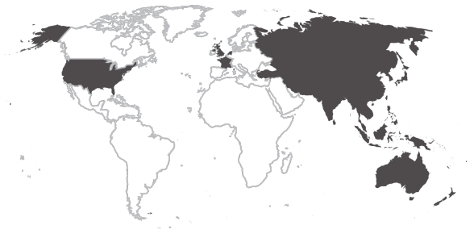
UN APCICT
Asian and Pacific Training Centre
for ICT for Development

Slide 3
Mandate & Major Activities
Human and Institutional ICT capacity of ESCAP member States
1
2
3
Capacity
Building
Technical
Assistance
E-learning
& Knowledge
Sharing Platforms
To deepen the knowledge of policymakers and civil servants
Policy, strategy

Slide 4
1
Capacity building programmes
ACADEMY
WIFI
PRIMER
of ICT Essentials for Government Leaders
Women ICT Frontier Initiative
Primer Series on ICTD for Youth
Policymakers
Civil Servants
Women Entrepreneurs
Policymakers
Future Leaders
Azerbaijan
Kyrgyzstan
Pakistan
The Academy Modules have been integrated into the Junior and Senior Leadership Programs of the Civil Service Training Institutions
Bangladesh
Lao PDR
Philippines
Bhutan
Mongolia
Sri Lanka
Cambodia
Indonesia
Myanmar
Thailand
Kazakhstan
Nepal
Viet Nam

Slide 5
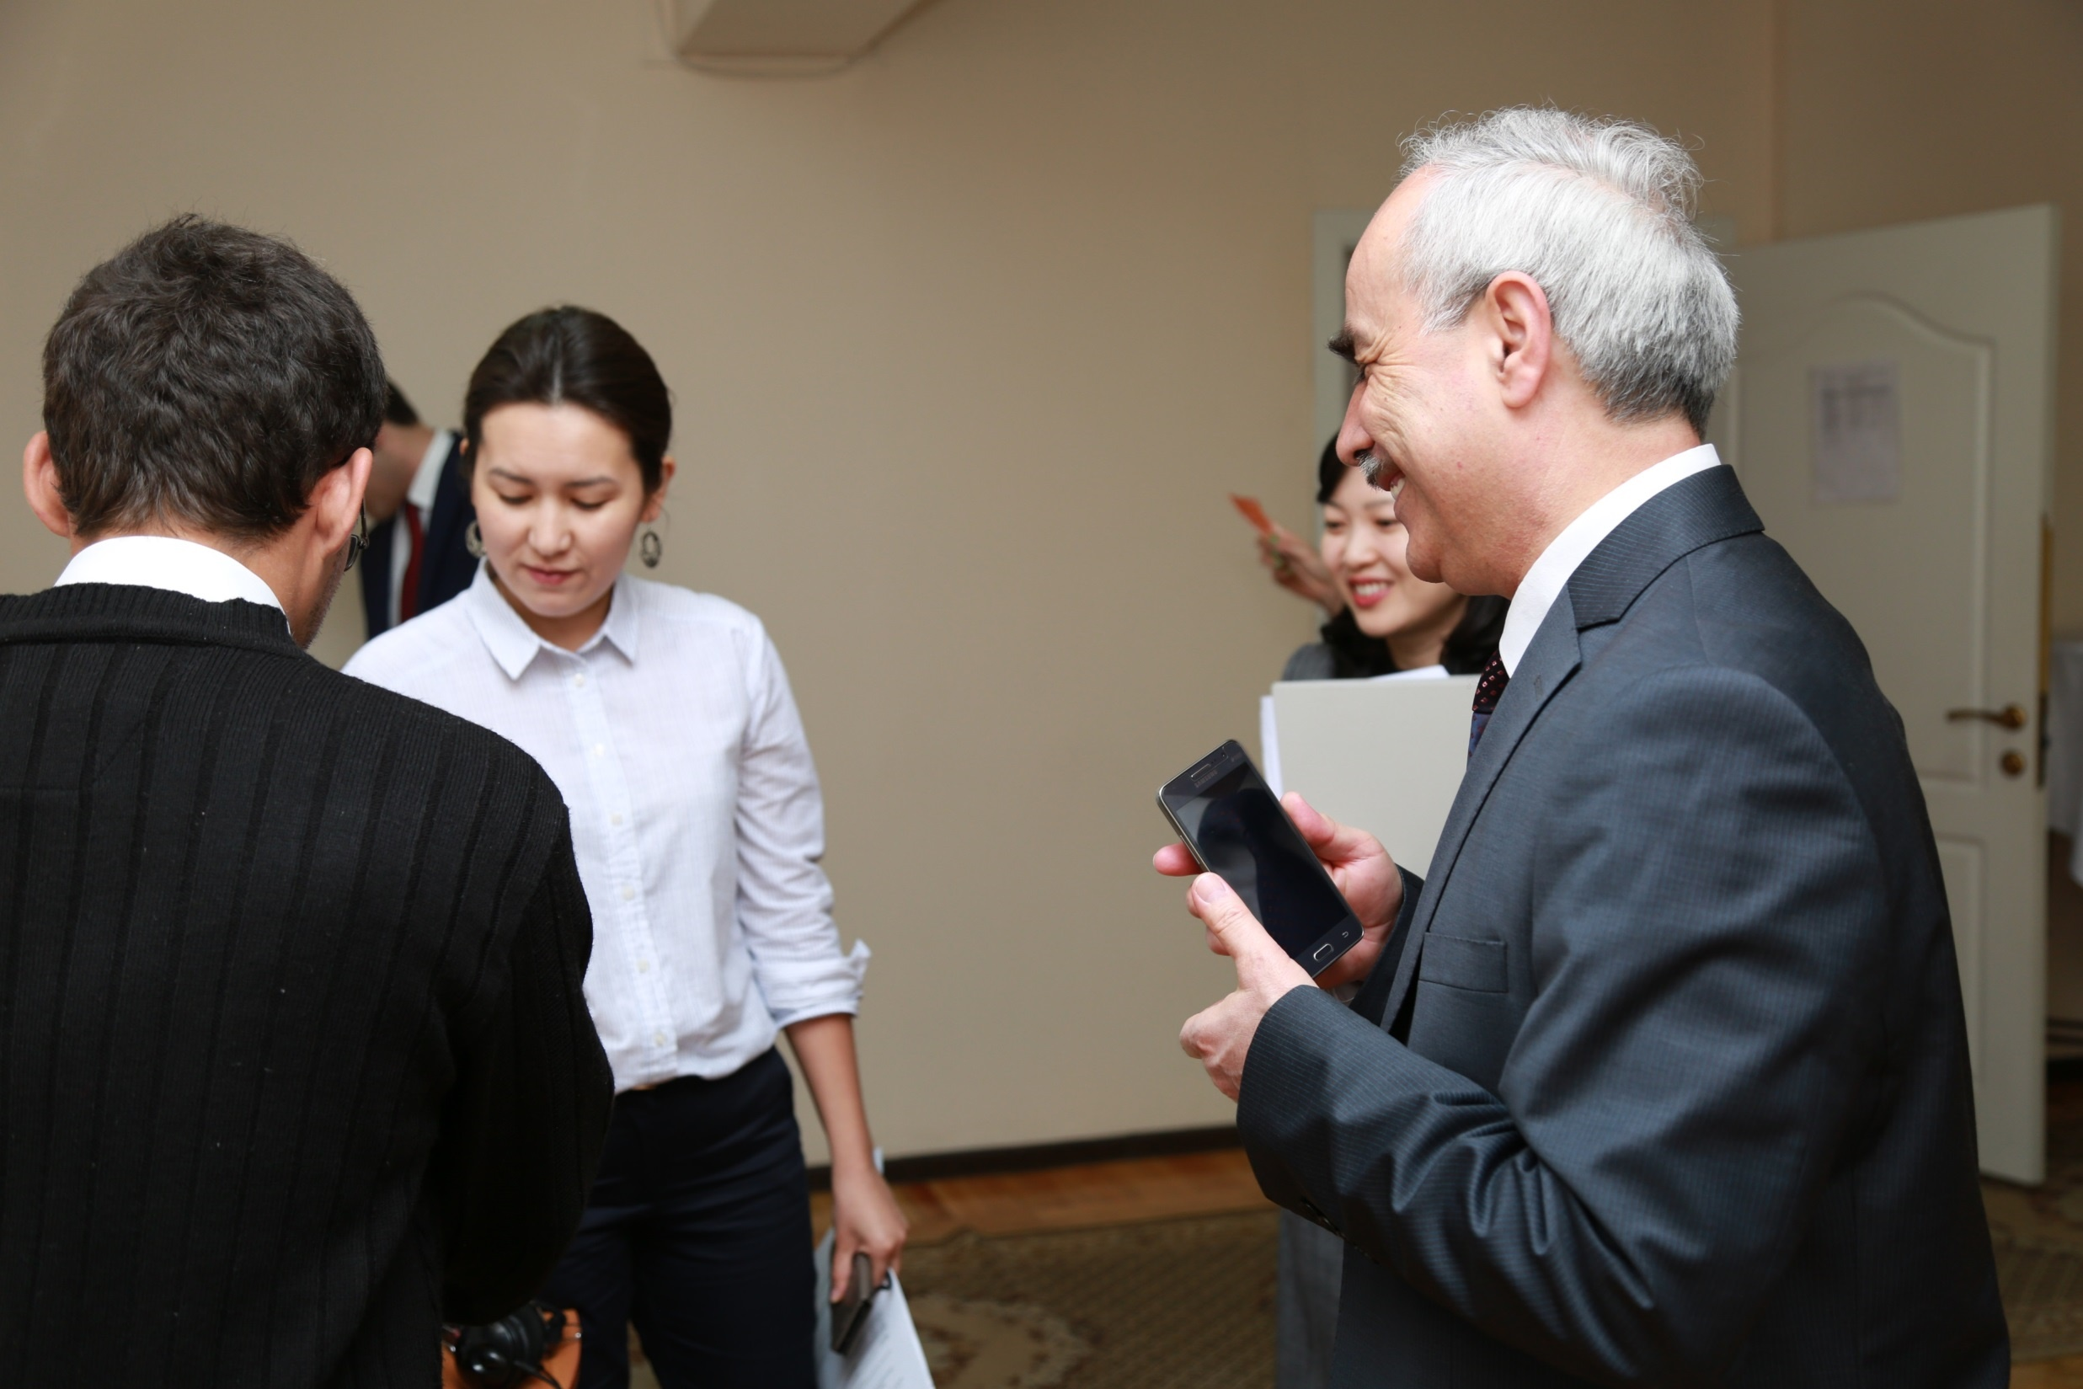
TRAINING PROGRAMMES
Introductory
Digital Inclusion
ICT for Sustainable D
ICT for Active Aging
Development Policy
ICT Project Mgmt.
ICT for Persons with Disabilities
Transboundary
Climate Change
Disaster Risk Mgmt.

Slide 6
ACADEMY: TRAINING PROGRAMMES
Digital Government & Transformation
ICT for New & Emerging Socio-Econ Issues
Digital government and transformation
ICT for Building Back Better (COVID-19)
Data-Driven Governance
Information Security & Privacy
Digital Connectivity
Social Media
Infrastructure co-sharing
for affordable broadband
Data Privacy and Protection
Frontier ICT Technology for Development
Avail. 4Q

Slide 7
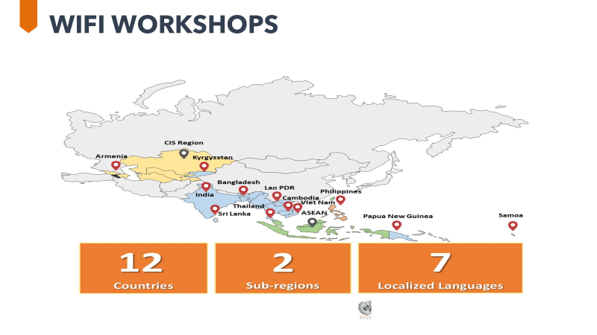
1
Capacity building programmes
ACADEMY
WIFI
PRIMER
of ICT Essentials for Government Leaders
Women ICT Frontier Initiative
Primer Series on ICTD for Youth
Policymakers
Civil Servants
Women Entrepreneurs
Policymakers
Future Leaders

Slide 8
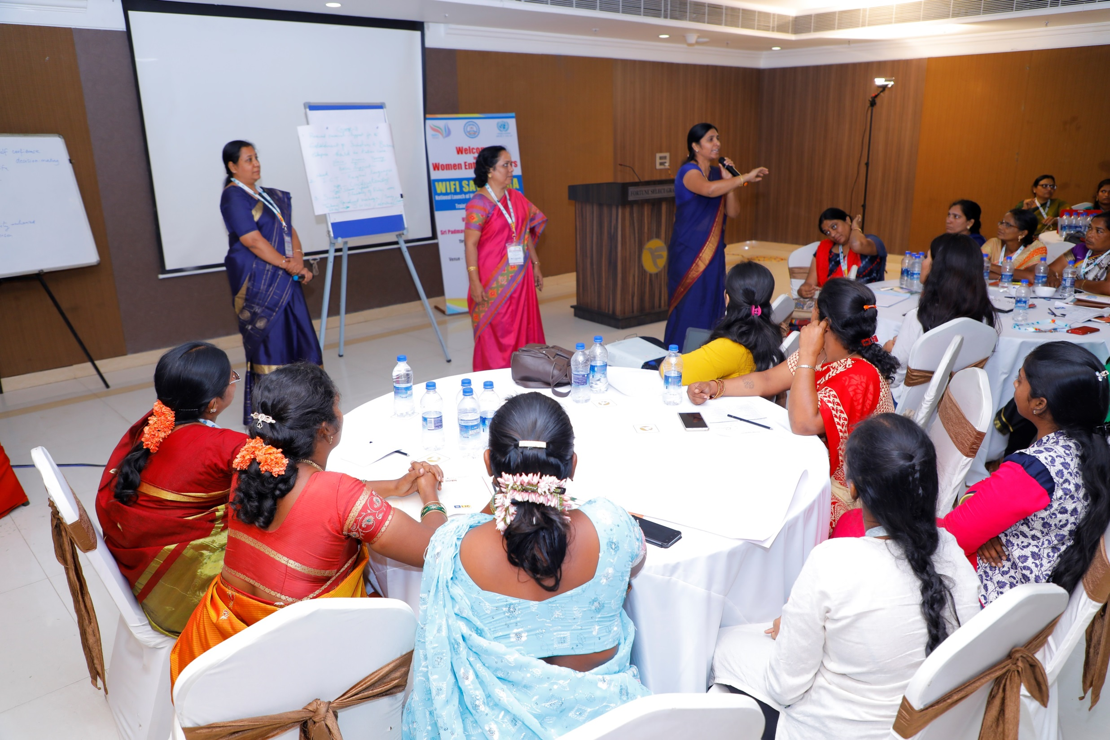
WIFI
Women ICT Frontier Initiative
5 modules
Women Entrepreneurs Track
Core Track
Policymakers Track
Women's Empowerment,
SDGs and ICT
Planning a Business Using ICT
An Enabling Environment for Women Entrepreneurs
Enabling Role of ICT
for Women Entrepreneurs
Managing a Business Using ICT

Slide 9
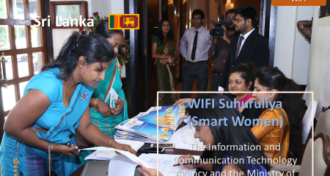
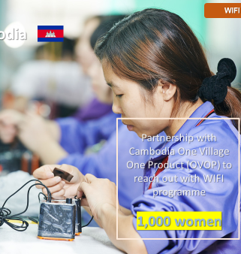

Slide 10
Canada is supporting the ESCAP project on
“Catalyzing Women’s Entrepreneurship” which will include ICT training to women entrepreneurs in 6 countries
Cambodia
Viet Nam
Nepal
Bangladesh
Fiji
Samoa
Notes:
Apcict is partnering with SHE Investments, to develop a mobile app that can be used by cambodian women entrepreneurs to manage their finances
HD: This is what usually Mr. Ko says formally. Doesn’t require additional information.

Slide 11
Youth
To turn today youths into future leaders

Slide 12
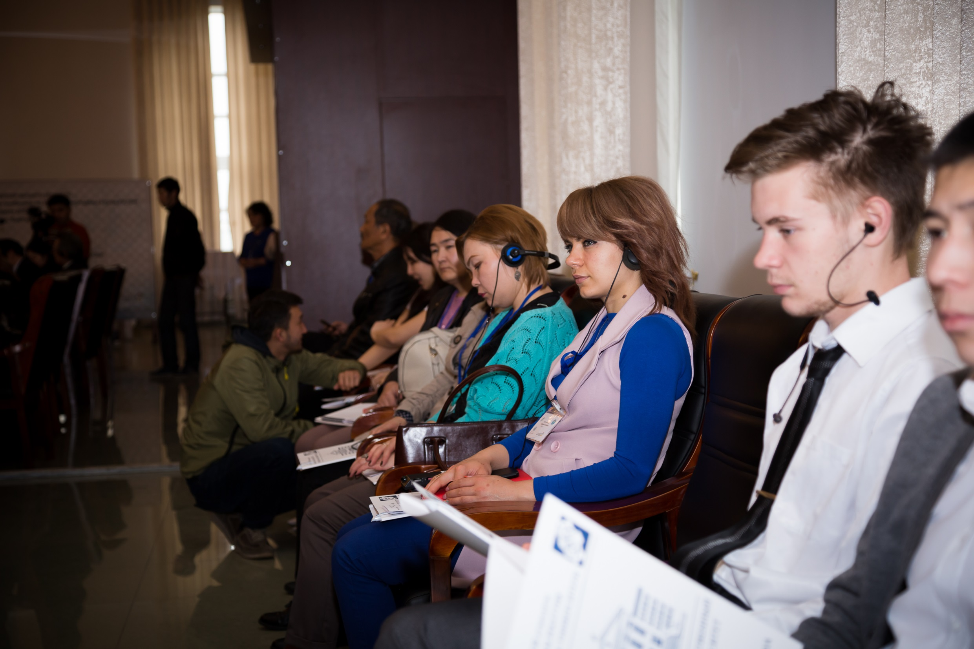
PRIMER
Primer Series on ICTD for Youth
Deliver key knowledge of ICT for Development (ICTD) to students and youth
An Introduction to ICTD
Project Management and ICTD
ICT for Disaster Risk Management
ICT, Climate change, and Green Growth
Social Media for Development

Slide 13
Technical Assistance
The Government of Maldives for the development of its digital government policy and providing customized training top policymakers/parliament members on digital government;
The Government of Maldives in developing their national data privacy legislation
The Government of Bhutan in the development of its digital
information literacy framework, data privacy legislation
Policy strategy
framework
Legislation draft
The Government of Indonesia in developing their national data privacy legislation
Curriculum
design
The Government of the Philippines for the development of curricula in ICT Academy
The Government of Cambodia for the development of curricula in Cambodia Academy of Digital Technology

Slide 14
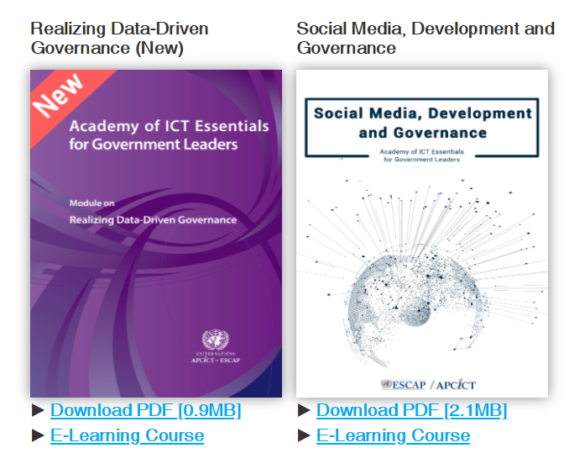
Notes:
June:where the new module of covid 19 to be placed?pls consult with Mr. Ko
HD: I have added it to slide #8 for time being

Slide 15
AVA e-learning

Slide 16
THANK YOU

