Slide 1
UNCITRAL: Legal Harmonization, Innovation, and the Digital Economy (22 OCTOBER 2021)
Athita Komindr, Head, UNCITRAL RCAP
유엔국제상거래법위원회 아시아태평양지역사무소 소장
Notes:
Distinguished speakers, guests, and students,
Greetings from the UNCITRAL Regional Centre for Asia and the Pacific in Incheon. My name is Athita Komindr, head of UNCITRAL RCAP.
It is a pleasure to deliver these remarks to celebrate the 30th Anniversary of the United Nations in Korea, which also coincides with the 10th anniversary of UNCITRAL RCAP’s opening its doors in Incheon with thanks to the government of the Republic of Korea.

Slide 2
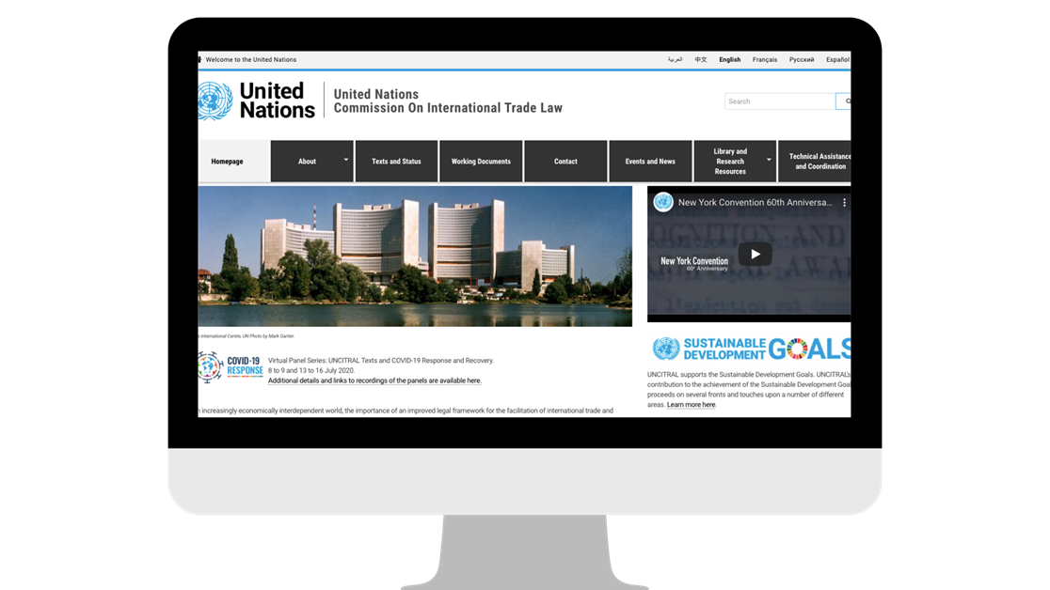
About UNCITRAL
The core legal body of the United Nations system in the field of international trade law
국제무역·통상·상거래법 분야의 유엔시스템 내 핵심법률기구
Established by United Nations General Assembly in 1966
1966년 유엔총회에 의해 설립됨
MANDATE:
Progressive harmonization and modernization of international trade law by preparing and promoting the use of legislative instruments in key areas of commercial law
목적:
상법 주요분야에서의 입법규범 활용 준비와 촉진을 통한 국제상거래법의 점진적 조화 및 현대화
UNCITRAL.UN.ORG
UNCITRAL.UN.ORG
Notes:
2
Allow me to briefly introduce UNCITRAL.
Based in Vienna, Austria, the United Nations Commission on International Trade Law (UNCITRAL) promotes the harmonization and modernization of international trade law to facilitate international trade and sustainable development. Since its inception in 1966, UNCITRAL has been focusing its work on trade in goods, but with the advent of the digital economy, future work topics such as data transactions, the use of Artificial Intelligence and automated services, online platforms all have a “service” component. We can witness an important shift in the focus of the topics for international law making. I firmly believe that it is the digital economy that would allow us to recover from the pandemic quickly and to address the challenges associated with climate change.

Slide 3
Where UNCITRAL fits in
Existing texts
Model Law on Electronic Commerce
Model Law on Electronic Transferable Records
Current work
IdM and trust services
Enabling digital trade
Future work
Automated contracting
Moratorium on customs duties
Future work
Consumer protection
Data transactions
Business protection
Access to data
Notes:
3
For over 20 years, e-commerce has been a major focus for the work for UNCITRAL, which has been at the forefront in the UN system in setting legal standards for doing business in the digital age
For example, in 1992 UNCITRAL adopted a law enabling electronic payments, followed by model laws on electronic commerce, on electronic signatures and, most recently, on electronic transferable records (bills of exchange, bills of lading and the like) – and the Electronic Communications Convention, which together have been adopted in over 100 countries worldwide.
UNCITRAL e-commerce instruments have been particularly successful in the Asia Pacific region. Most AP States have already adopted at least one or more, including the Republic of Korea, with more States to follow soon.
In addition, UNCITRAL e-commerce instruments are benchmarked in free trade agreements as enablers of cross-border e-commerce and digital trade. For example, the Regional Comprehensive Economic Partnership, which South Korea has signed and may soon ratify, recommends State Parties to adopt or maintain a domestic legal framework for electronic transactions based on the Model Law on Electronic Commerce and the Electronic Communications Convention
As a central and coordinating agency within the UN system for addressing legal issues related to digital trade, UNCITRAL has a key role to play to develop the right framework. There are many challenges in today’s digital economy, where systems and platforms are used for the supply of goods and services, for the supply chain management and for dispute resolution. We need rules that apply across different systems while also accommodating different trading practices that different systems allow.
As an illustration, UNCITRAL is looking at how Artificial Intelligence is used in commercial relations. One interesting aspect of that work is how international standards affect the legal recognition of Artificial Intelligence by commercial parties in their legal relations with one another. Work on Artificial Intelligence contracting is an opportunity for UNCITRAL to also consolidate and fine-tune its existing opus of legislative texts on electronic transactions to ensure that they reflect contemporary business practices, including those associated with the “platform economy”.

Slide 4
Common Themes
Enabling digital trade
Moratorium on customs duties
Consumer protection
Business protection
Access to data
Notes:
4
The success of UNCITRAL texts requires provisions that address the needs of business of all sizes and that ensures legal protection to all. The UN member States that come to UNCITRAL sessions represent States in all stages of development, and UNCITRAL is required by its statute to “bear in mind the interests of all peoples, and particularly those of the developing countries, in the extensive development of international trade”. UNCITRAL has noted that future work on legal issues related to the digital economy could assist efforts to bridge the digital divide, and this spirit, consistent with the Sustainable Development Goals, is guiding the exploratory and preparatory work that we are undertaking.

Slide 5
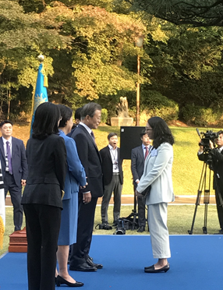
Promoting Harmonization and Trade in the Asia-Pacific
UNCITRAL’s only regional centre; located in Incheon, Republic of Korea; opened 2012
7 AP jurisdictions joined New York Convention since 2012
3 AP jurisdictions adopted MLETR since 2017
Main contributors: - Republic of Korea
- HK SAR, China
2019-2020: 60+ TAC activities in 16 AP jurisdictions
6 AP jurisdictions joined ECC since 2012
40 AP jurisdictions adopted MAL (18 since 2012)
SDG 16: Access to Justice and Rule of Law
2021: 5 flagship activities
Notes:
5
Before I end my remarks, allow me to briefly introduce my office, the UNCITRAL Regional Centre for Asia and the Pacific, which is UNCITRAL’s only regional centre and was established in Incheon, Republic of Korea in 2012.
Supported by the South Korean government and also Hong Kong SAR China, the Regional Centre carries out UNCITRAL’s mandate in approximately 60 jurisdictions in the Asia Pacific region, working with government officials, the judiciary, legal and business experts, and academia to further the progressive harmonization and modernization of international trade and commercial law by promoting the use, adoption, and uniform interpretation of UNCITRAL texts, and providing capacity-building in this regard.
To students in the audience, UNCITRAL in Vienna and RCAP in Incheon have internship application opportunities twice a year usually in December and June. We have had successively diverse batches of interns at UNCITRAL RCAP from all corners of the world and of course from China, and would encourage those interested to apply.

Slide 6
https://uncitral.un.org
Notes:
We also invite you to take UNCITRAL’s first online training course - “Introduction to the United Nations Commission on International Trade Law” – which was launched on 12 July 2021. Developed in collaboration with the International Training Centre of the International Labour Organization (ITCILO), this interactive and self-paced course introduces users to legal harmonization, UNCITRAL’s methods of work, and how UNCITRAL texts contribute to the achievement of the sustainable development goals.
Currently available in English, the three modules are the first of a forthcoming series. An electronic certificate is downloadable from the platform for users who complete all three modules.
The course is available free of charge on the UNCITRAL website. Users will be able to enroll in the course upon creating an account.

Slide 7
UNCITRAL RCAP 2021 EVENTS
UNCITRAL
Asia Pacific Day
10th Asia Pacific ADR Conference
Seoul, 4 – 5 Nov.
Theme: “Innovating the Future of Dispute Resolution beyond 2021: The Journey Continues”
UNCITRAL Special Session
Universities in AP region
mid-Sept. – mid-Dec.
Theme: “Enabling MSMEs and Assisting Economic Recovery through Legal Harmonization”
Seoul, 2 – 3 Nov.
Theme: “UNCITRAL and Regional Developments
on Arbitration and Mediation”
Incheon Law and
Business Forum
HK Judicial Summit
HK SAR, China, 1 – 2 Nov.
Theme: “Sustainably Adapting to a New Normal”
Incheon, 6 – 7 Sept.
Theme: Navigating the storm: Helping MSMEs set sail with legal harmonization
Notes:
For participants interested in learning more, please join the Regional Centre’s virtual events throughout the region, especially our November flagship events and Asia Pacific Day academic series.

Slide 8
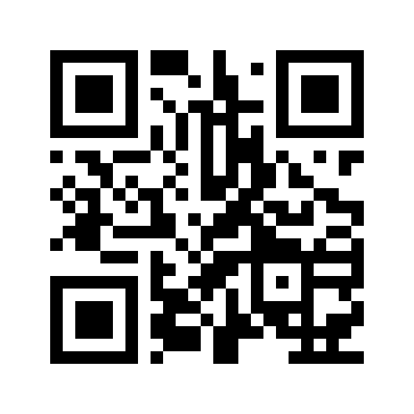
THANK YOU
경청해주셔서 감사합니다
Subscribe to RCAP’s mailing list!
RCAP 메일링리스트에 가입하세요
Notes:
UNCITRAL RCAP invites you to peruse our webpage and subscribe to our mailing list via the QR code.
Thanks again to the organizers, and I look forward to any questions.

