Slide 1
Panel Discussion: Innovation and Digital Transformation UNIDO ITPO Korea
22 October 2021
CHO Hyundong

Slide 2
A Shift in the Competitiveness of the Existing Value Chain in Korea
1960-1980: The country (government, society, etc.) made effort at the national level to build factories and establish companies, which led to the birth of today’s leading global conglomerates
Government
Financial & Business Support
Resources directed according to necessities
Provision of business opportunities and subsidized manufacturing sites
Society
Provision of labour
Creation of the “hard working” social atmosphere and working culture to boost productivity
Companies
Manufacturing-based Companies

Slide 3
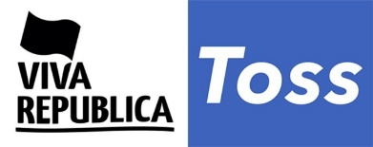
A Shift in the Competitiveness of the Existing Value Chain in Korea
Now (2021): In need of active supportive policies by viewing startups not as simply starting a new business but as the country’s future competitiveness
Government
TIPS Town
Mapo Innovation Town
Korea Credit Guarantee Fund
Multiple startup support centres e.g., Korea Institute of Startup & Entrepreneurship Development
Society
Accelerators, VCs
Ecosystem Creators
Co-working Space
Startups
IT/Service-based Companies

Slide 4
Key Performances of the Start-up Ecosystem in Korea
Entrepreneurs/Start-ups | Corporation | Funding
Number of Start-up Companies(*): 996,779 Start-up Rate among the entire enterprises(*): 15.0% | Survival Rate (1, 5 years respectively): 63.7%, 31.2% Employment Ratio for Start-ups: 6.75% Number of Unicorns: 14 | Venture Capital Investment: $3.9 Billion Angel Investment: $500 Million Alternative Finance: $800 Million
Support Organization/Infrastructure | Technology/Knowledge | Globalization
Accelerators: 308 Coworking Space: 229 | Patents per million people: 461.2 Patents Investment in R&D versus GDP: 4.2% | Proportion of Overseas Market Entry: 7%
(*) newly-set up companies in 2019

Slide 5
Government’s Start-up support policy in Korea
Expansion of government-led start-up encouragement policy in the past five years
Ministry of SMEs and Startups “Start-up support budget” gradually increased from:
USD 140 million in 2010 to USD 850 million in 2020
Major Policy Improvements
Policy | Description
Levies exemption | Significant expansion of types of levies exemption for manufacturing sector start-ups from December 2018
Reduction of Tax burden | Higher tax-deductible ratio for Angel Investments in start-ups (100% tax deduction for up to approx. USD 30,000 from 2018)
Expansion of Start-up Visa system | Expansion of technology start-up visas and preparatory visas to promote the globalization of the domestic start-up ecosystem

Slide 6
Private sector Start-up support ecosystem
Conglomerate Accelerators
Private Accelerators

Slide 7
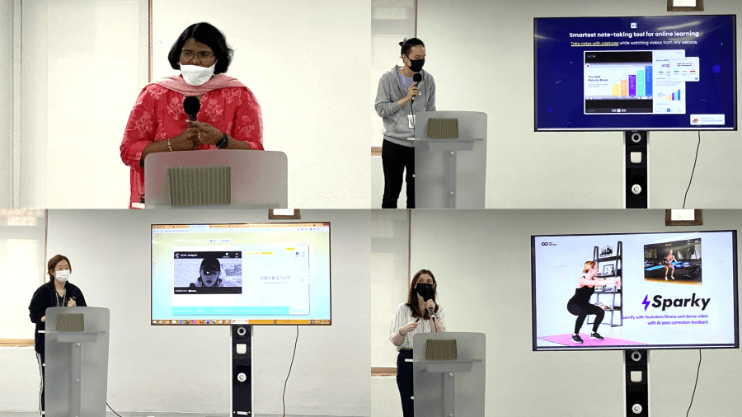
UNIDO’s intervention to support Start-ups
Close interaction with Diplomatic Corps in Korea
India
Sri Lanka
Indonesia
Vietnam
Colombia
⁞
Ambassadors and commercial counsellors of the major partner countries residing in Korea are invited to ITPO Korea office
Arrange business meetings between the delegation and Korean startups

Slide 8
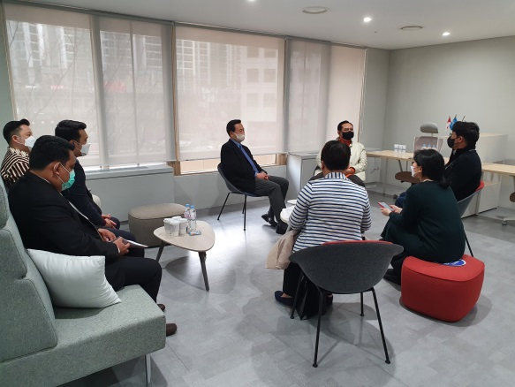
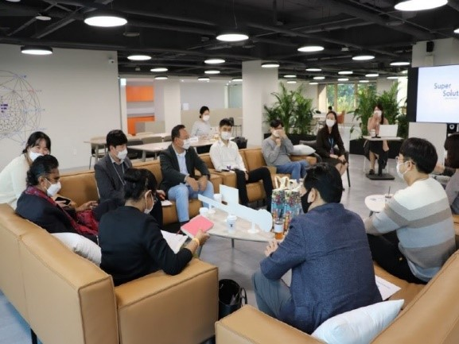
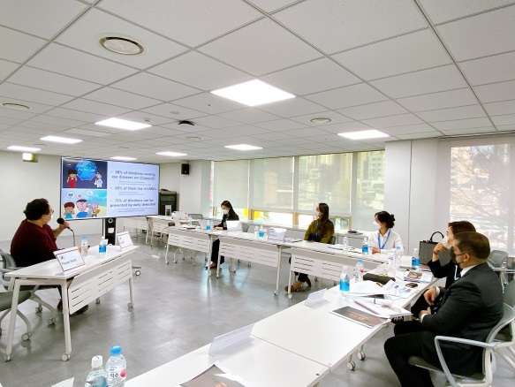
UNIDO’s intervention to support Start-ups
Operation of Global Connecting Lounge
Operation of
Global Connecting Lounge
@world’s largest startup hub
Taking advantage of the geographical benefit, being located in the world’s largest startup complex in Seoul, ITPO Korea will strengthen our network with domestic start-ups
Operate “Global Connecting Lounge” to support overseas expansion of the startups by linking them with the delegation invited by ITPO Korea

