Slide 1
Alternative Data Production in the Digital Society
Hyun Jung Park
Coordinator, UNODC-KOSTAT CoE

Slide 2
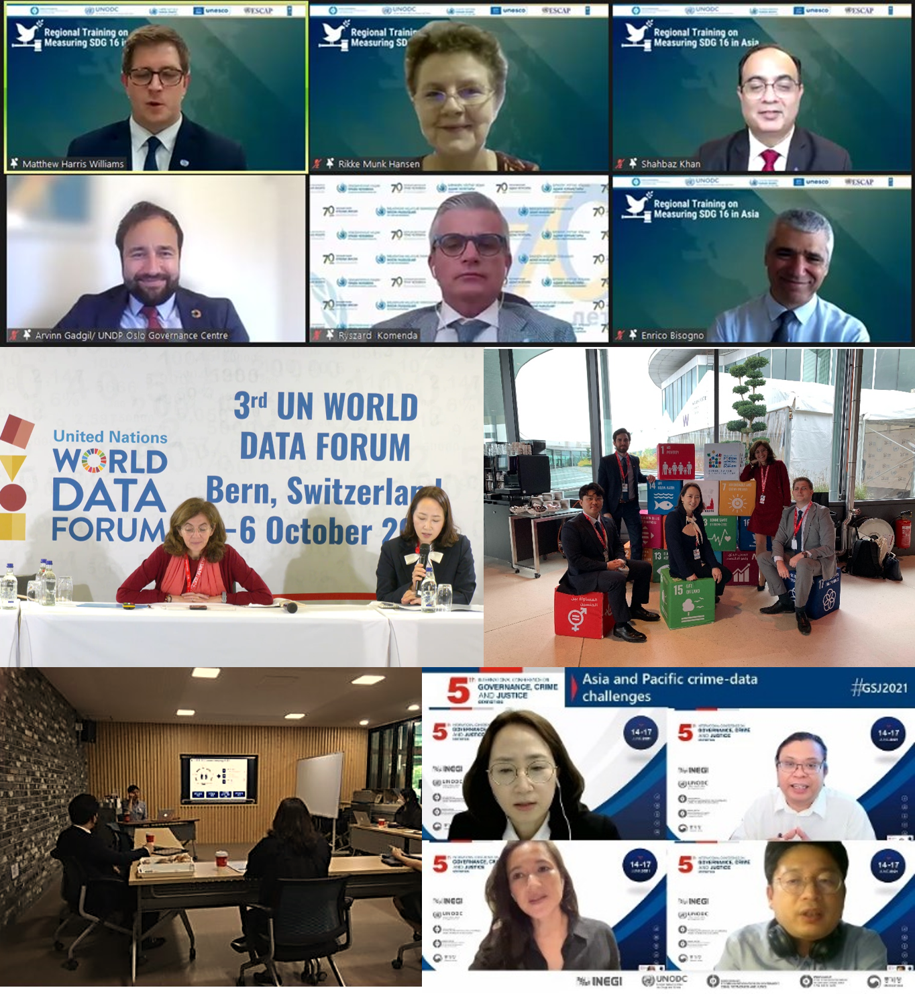
Centre of Excellence (CoE)
Background:
Political/ Institutional Support
Technical Support
Knowledge Sharing
Founded 2019
UNODC & KOSTAT
Knowledge hub:
Production
Collection
Analysis
Dissemination

Slide 3
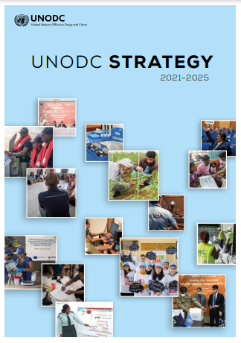
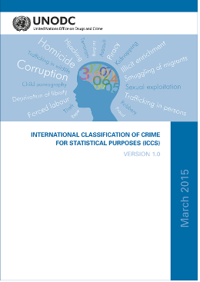
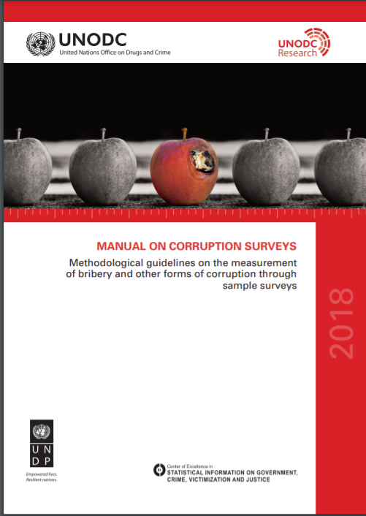
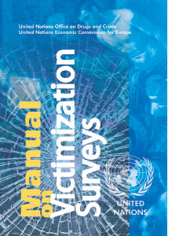
UNODC Strategy 2021-2025
Leave no one behind:
Stronger research, evidence-based policy, and data analysis
Combine traditional data sources with innovative solutions, big and smart data:
i.e. Geospatial information systems on artificial intelligence-based methods
“What matters on drugs and crime, when it matters” - UNODC

Slide 4
Crime Statistics with COVID-19
Data Collection Limitations:
Face-to-Face
Social Distancing
Non-Face-to-Face
Examine how we can measure pandemic-triggered crimes by utilizing technological innovations.

Slide 5
Statistics Korea (KOSTAT): new transition
A cloud-based real-time data collection system
- safely connects and analyzes scattered public data or big data
with the latest encryption techniques, homomorphic encryption
A new concept of national statistics system
- stores each data safely like ‘ice cubes’
- securely links and analyzes them with the latest technique
only when necessary
A system using the hub-and-spoke model
- the National Statistical Register such as Population and Household
Statistical Register and Business Register as hubs.
i.e. when producing pension statistics, safely using occupational, old-age, and housing pensions as spokes to maximize the value of data utilization.

Slide 6
Possible Alternative for Crime Statistics
Pandemic: challenge for
data collection
Apply K-Statistics system to crime statistics
Utilize digital data collection to capture ‘dark figure’
Administrative Data
Crime-related
Public Data
Crime Report
Big data

Slide 7
CoE: Looking Forward
CoE plans:
Continue technical support and research activities to improve crime statistics in the Asia-Pacific region.
Share innovative cases for data collection and system construction in the future so that they can be used in the region.
Hope that it can be provided as such a solution that safely links scattered data with the latest encryption technology.

Slide 8
Thank you!
Hyun Jung PARK
Coordinator
hyun.park@un.org

