Slide 1
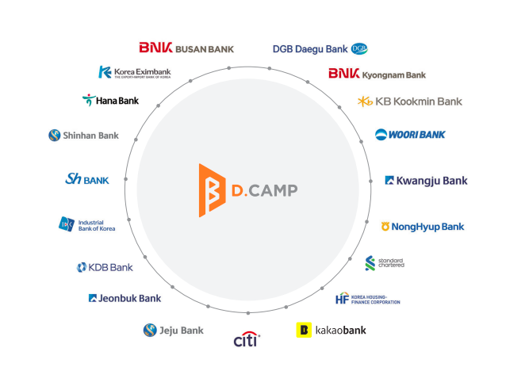
Banks Foundation for Young Entrepreneurs
D.CAMP
The base camp for all startups.
Notes:
원본 : 브로셔 27P

Slide 2
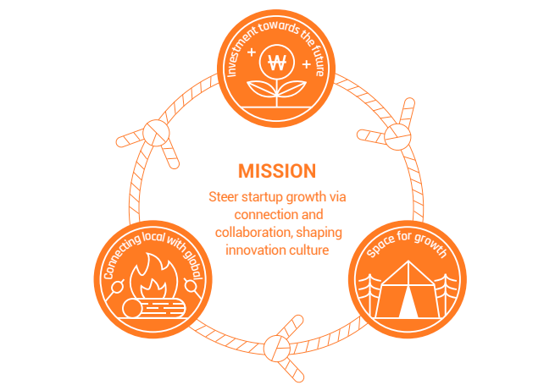
MISSION
Notes:
원본 : 브로셔 2P

Slide 3
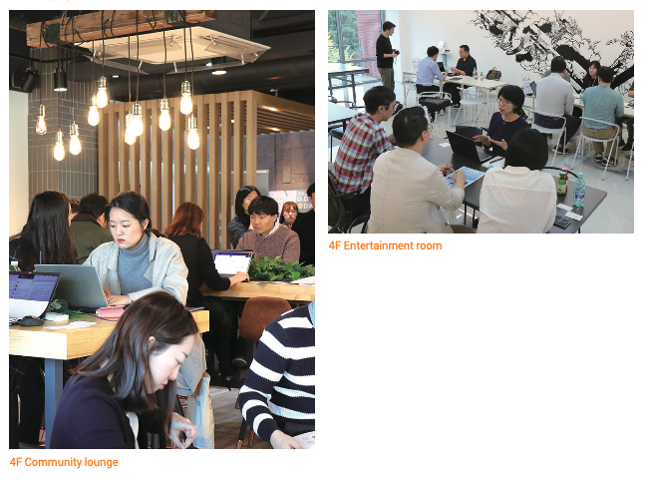
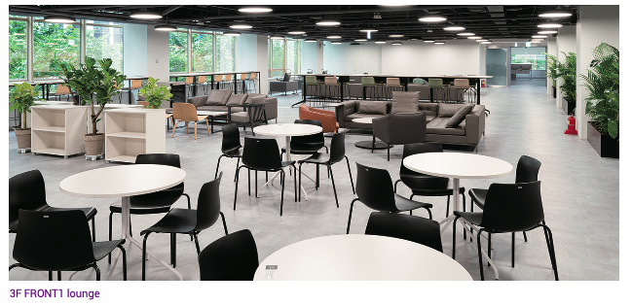
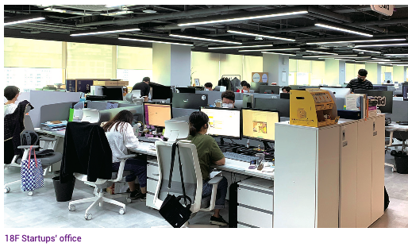
Space for Growth
D.CAMP
FRONT1
Notes:
브로셔 또는 구글포토내 사진 참고

Slide 4
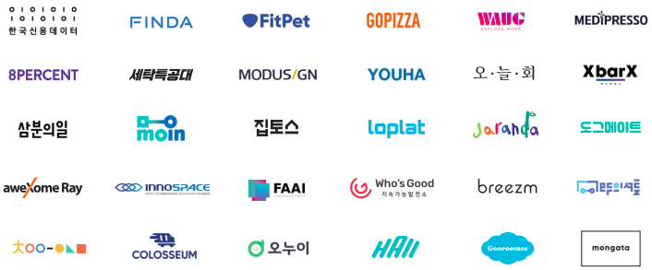
Direct & Indirect Investment
Companies Amount Follow-up investment
130 $15.4M $229.6M
Funds Commitment Accrued payment Total fund value
25 $660.4M $416.6M $9.3B
Notes:
원본 : 브로셔 22-23P 포트폴리오 부분

Slide 5
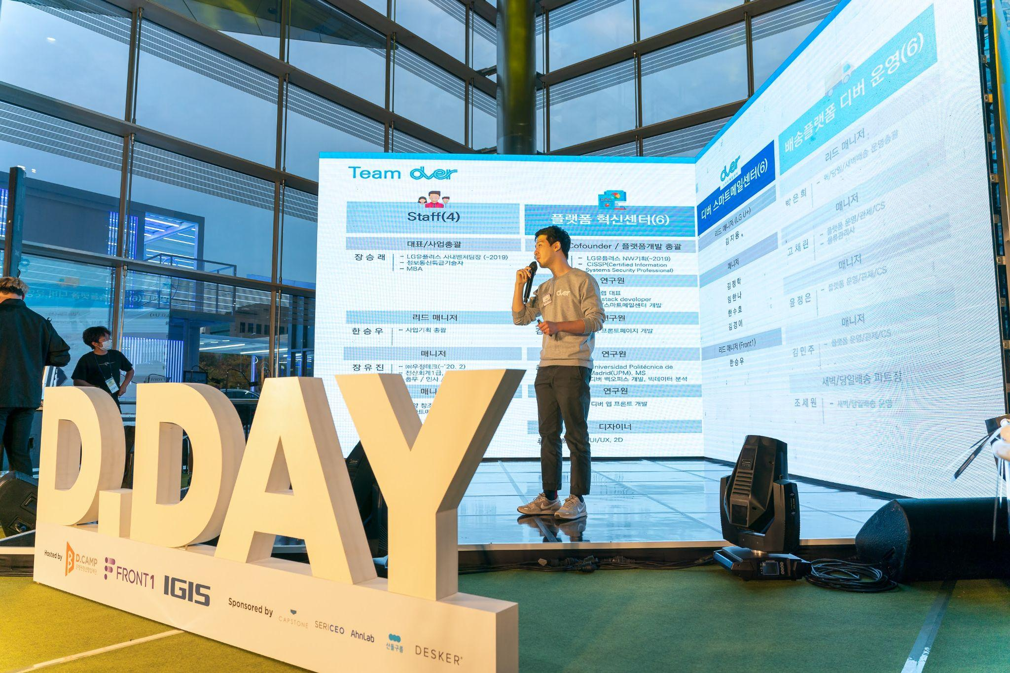
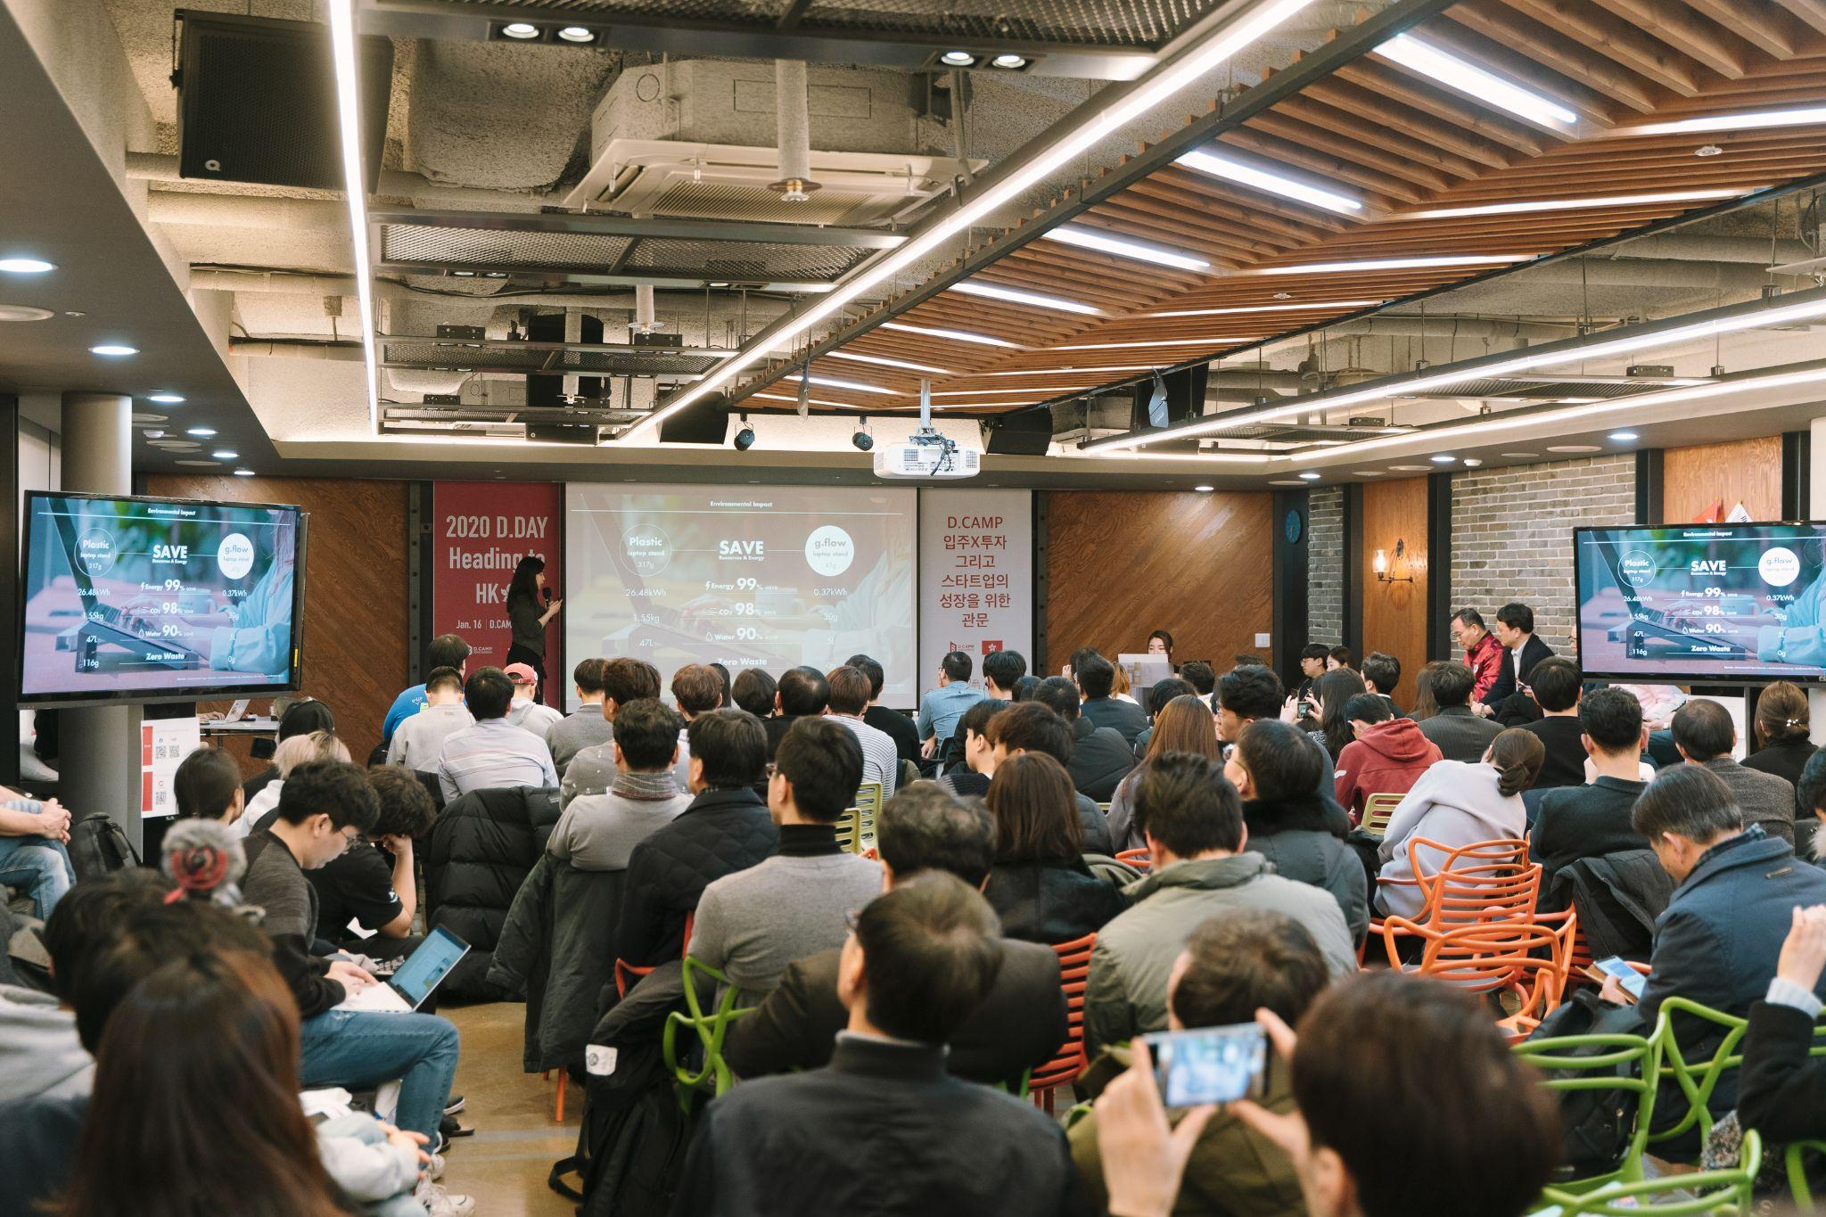
Monthly Demo Day, D.DAY
Events
84
Applications
5,379
Finalists
433
Sponsors & Crowd
12,518
(As of Mar, 2021)
Notes:
원본 : 브로셔 12-13P

Slide 6
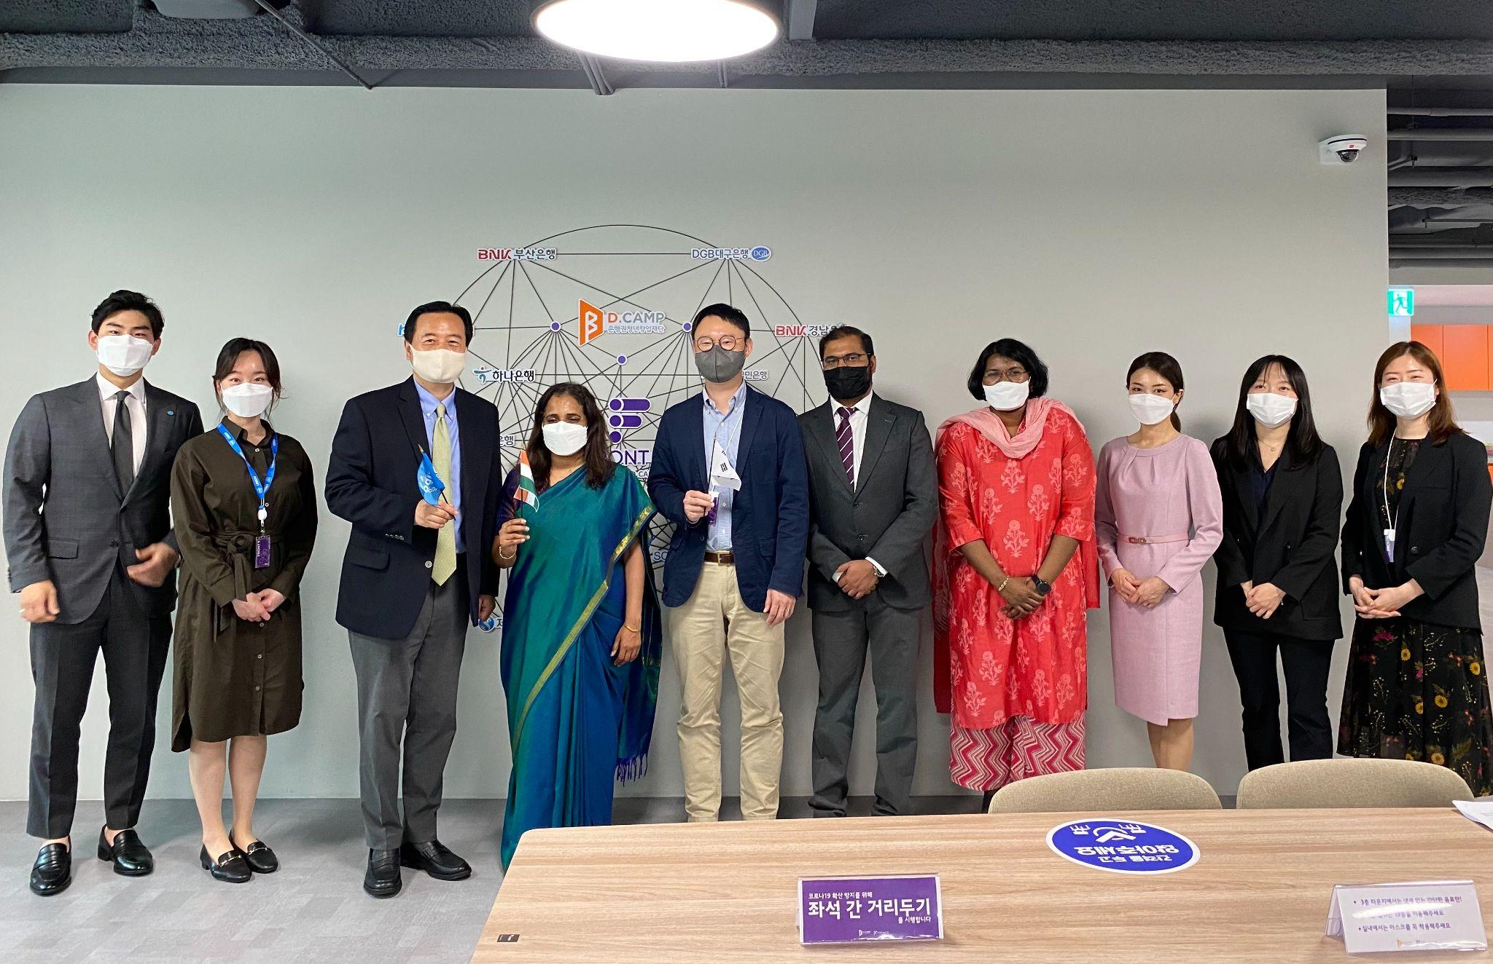
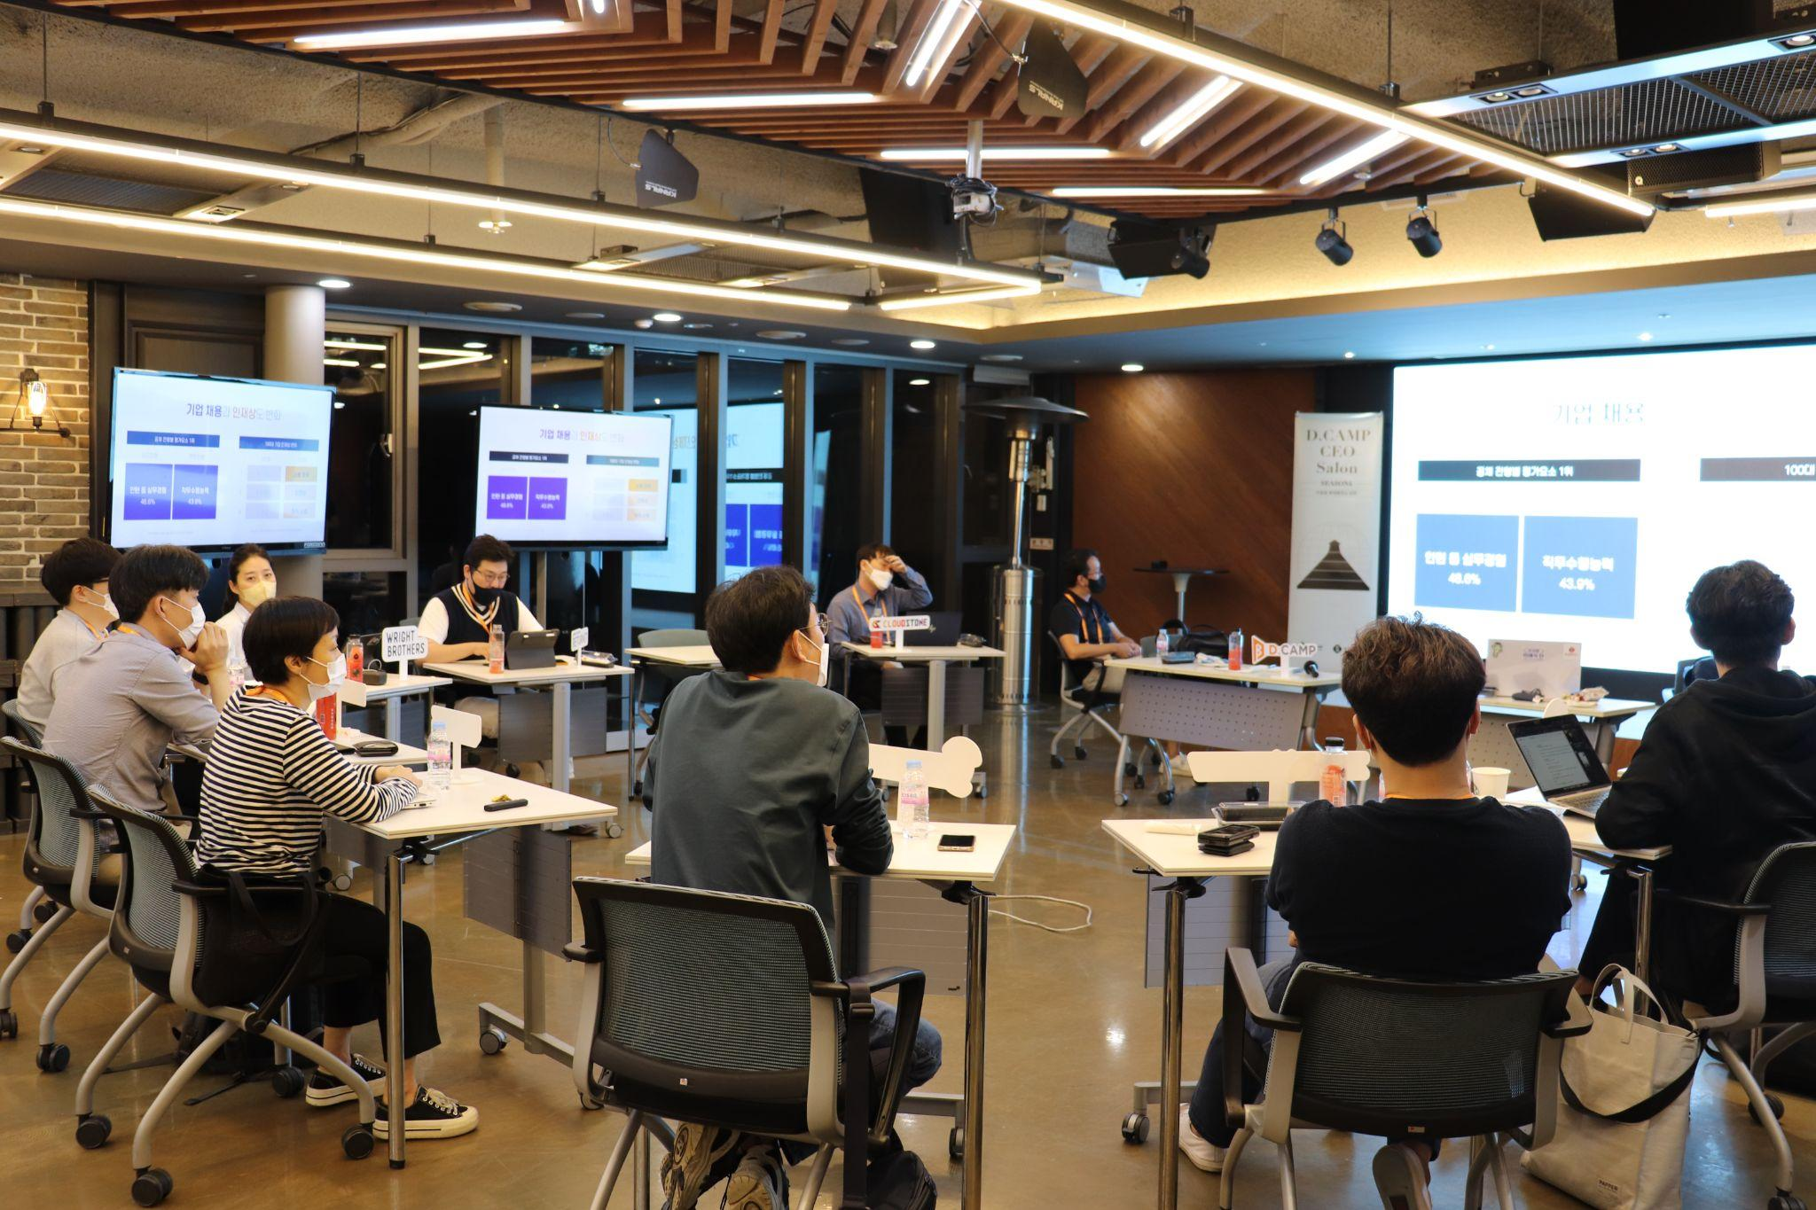
Move in & Growth Program
OFFICE HOURS
Focus Mentoring Program
SALON
Group Mentoring Program
events
428
participants
1,553
Education & Seminars
245
participants
9,886
Notes:
원본 : 브로셔 14-16P

Slide 7
D.CAMP Representative Families
Notes:
원본 : 브로셔 27P

Slide 8
Thank you

