Slide 1


United Nations Economic and Social Commission for Asia and the Pacific
유엔아시아-태평양 경제사회위원회
Sangmin Nam
Deputy Head, East and North-East Asia Office

Slide 2
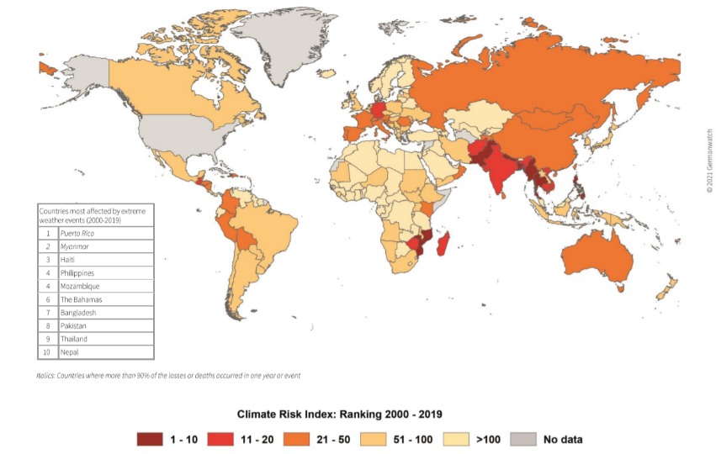
ESCAP’s Mandate on Multilateral Climate Cooperation
“Promotes cooperation among its 53 member States and 9 associate members in pursuit of solutions to sustainable development challenges.”
AP region counts for more than 50% global GHG emissions
High level of climate risks
Notes:
The Asia-Pacific region is currently source of half of the global GHG emissions and with compounding risks associated with climate change. Climate change and climate-induced disasters fundamentally threaten development in Asia-Pacific.

Slide 3


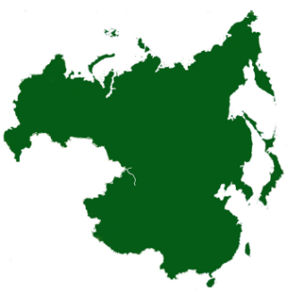
ESCAP East and North-East Asia Office: mobilizing cooperation and building subregional action
NEASPEC
Air Pollution
Nature Conservation
Land degradation and climate change
Low carbon cities
Marine Protected Areas
New agenda
Six North-East Asian countries
36% of global GHG emissions in 2018
69% of ESCAP region emissions
Critical role in stabilizing global temperature
Forum on Carbon Neutrality Goals of China, Japan and Korea, 29-30 November 2021

Slide 4


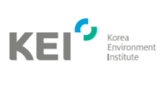





Partnership with the ROK on Climate Change
Collaborating for multilateral and subregional cooperation
Utilizing technical expertise
Providing financial resources
Notes:
[KEI] Under NEASPEC, our office operates the North-East Asian Low Carbon City Platform with the goal of developing this platform into a fully functional one to support communications and cooperation among stakeholders, and promote awareness and capacity for developing and implementing low carbon city plans.
[KOICA] “ASEAN Climate Readiness Programme” as a partnership between KOICA and UNESCAP with the participation of the six targeted countries – Cambodia, Indonesia, Lao PDR, Myanmar, Philippines, Viet Nam, UNEP and UNDP launched at COP25.
[SINGG][MOE][KEC]
[KEITI] Carbon Footprint

Slide 5
United Nations Office for Sustainable Development
Ms. Yujeong Kim
Senior Development Management Expert, UNOSD

Slide 6

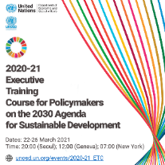
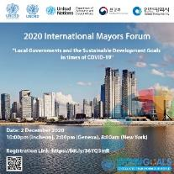
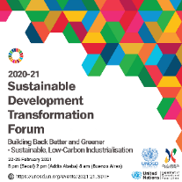
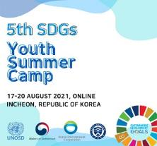
UNOSD’s Mandate on Sustainable Development
Supporting development pillar of the United Nations Secretariat by ensuring international cooperation in the pursuit of sustainable development for all.
Strengthening the capacity of Member States to undertake integrated sustainability transformation to the 2030 Agenda and the SDGs, and other internationally agreed development goals.
Assisting developing countries in developing and implementing strategies and policies for sustainable development.

Slide 7
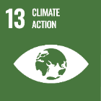

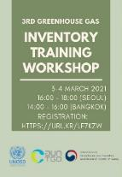
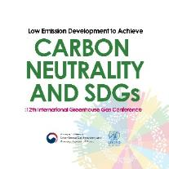
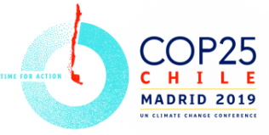
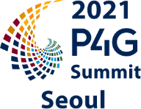

UNOSD’s Mandate on Climate Action
Greenhouse Gas Inventory System Training Workshop
International Greenhouse Gas Conference on “Low Emission Development to Achieve Carbon Neutrality and SDGs”
Conference of the Parties to the UN Framework Convention on Climate Change

Slide 8
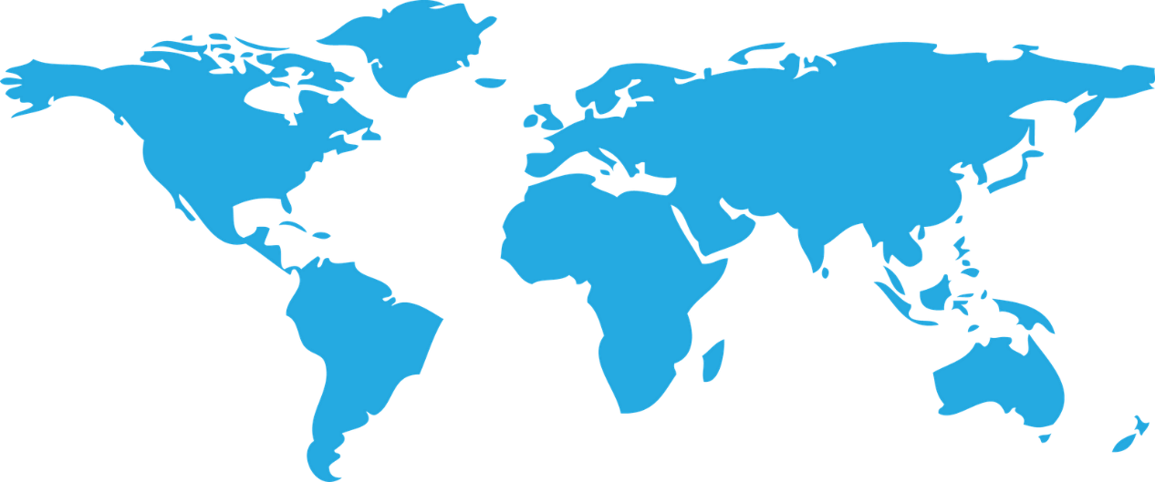


UNOSD’s Contributions to Advance Climate Action with the ROK
28
43
35
172 Member States
43 in Asia
51 in Africa
28 in Europe
35 in Latin America and Caribbean
15 in Oceania
89% of Member States
81% of SIDS, LDCs, and LLDCs
51
15
172 Member States / 3500+ Participants / 120 Activities

Slide 9



UN Office for
Disaster Risk Reduction
Office in Incheon for Northeast Asia
&
Global Education and Training Institute
(UNDRR ONEA & GETI)
International Cooperation
#OnlyTogether #DRRDay
Notes:
Good morning and thank you to the MOFA and our UN family for organizing this important celebration

Slide 10


UNDRR Mandate > Protecting People
Oversee the Sendai Framework for Disaster Risk Reduction implementation - the global blueprint to reduce disaster risk and losses
Works together with the 2030 Agenda for Sustainable Development and other 2030 Agenda - including the Paris Agreement on Climate Change
Support countries globally to implement and monitor the Sendai Framework and share what works to
reduce existing risk and prevent the creation of new risk.
ONEA supports these efforts in Northeast Asia while
GETI facilitates global capacity development for climate and disaster resilience planning and action and city-to-city learning as the global secretariat for Making Cities Resilient 2030.
Vision: A world where disaster risks no longer threaten the well-being of people and the future of the planet
Notes:
So how does our mandate contribute and supports the Republic of Korea’s multilateral efforts on protecting people?
UNDRR’s vision for a world where disaster risk no longer threatens the well-being of people and the future of the planet – a vision that underscores that reducing risk is everybody’s business and one that requires multilateral cooperation
Protecting people is core to SDGs, the UNDRR mandate, and Korean policies – including for disaster risk reduction and climate change adaptation.
Established by the UN GA in 1999, UNDRR is the focal point to ensure synergies across disaster risk reduction activities
UNDRR overseas the implementation of the Sendai Framework for Disaster Risk Reduction adopted in 2015 – the global, action-oriented blueprint for reducing disaster risk and losses from natural and man-made hazards and related environmental, technological and biological hazards and risks
The Sendai Framework works hand-in-hand with the SDGs and other 2030 Agenda agreements, including The Paris Agreement on Climate Change.
UNDRR supports countries the framework’s implementation, monitoring and sharing what works to reduce existing risk and prevent the creation of new risk, including climate change adaptation
From our office here in Incheon, ONEA supports efforts in Northeast Asia (China, Japan, Mongolia, Republic of Korea and DPR Korea) while GETI facilitates global capacity development for climate and disaster resilience planning and action and city-to-city learning as the global secretariat for Making Cities Resilient 2030.

Slide 11
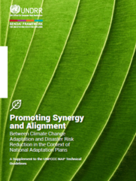
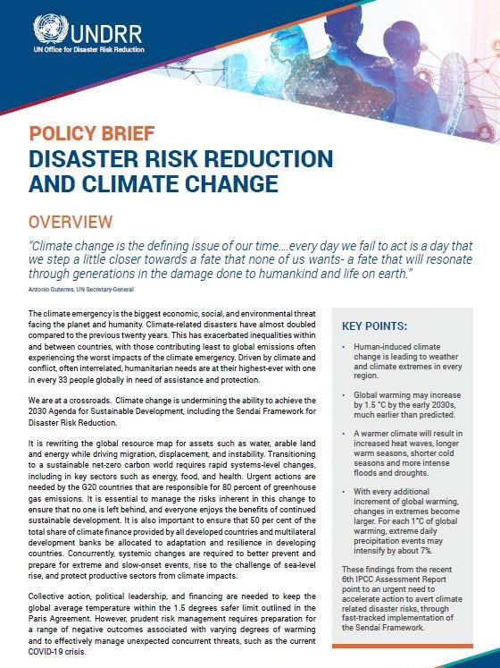
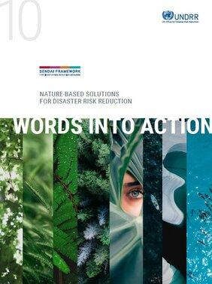
UNDRR Mandate > Protecting Planet
The Sendai Framework calls to invest in the
economic, social, health, cultural and educational resilience of persons, communities and countries and the environment
Promote and provide guidance to scale up comprehensive climate and disaster risk management – including how to integrate the DRR agenda with the climate agenda
UNDRR helps enable international cooperation for Sendai Framework implementation which is vital for good global risk governance in the face of planetary emergencies
Notes:
Protecting planet is also core to the SDGs, UNDRR’s mandate and Korea’s policies for disaster risk reduction and climate change adaptation.
The Sendai Framework calls to invest in the economic, social, health, cultural and educational resilience of persons, communities and countries and the environment
UNDRR promotes and provides guidance to scale up comprehensive climate and disaster risk management – including how to integrate the DRR agenda with the climate agenda among others
This approach puts risk to human and ecological systems at the centre of planning and action and promotes nature-based solutions and links with environmental conventions
UNDRR helps enable such international cooperation which is vital for good global risk governance in the face of planetary emergencies

Slide 12
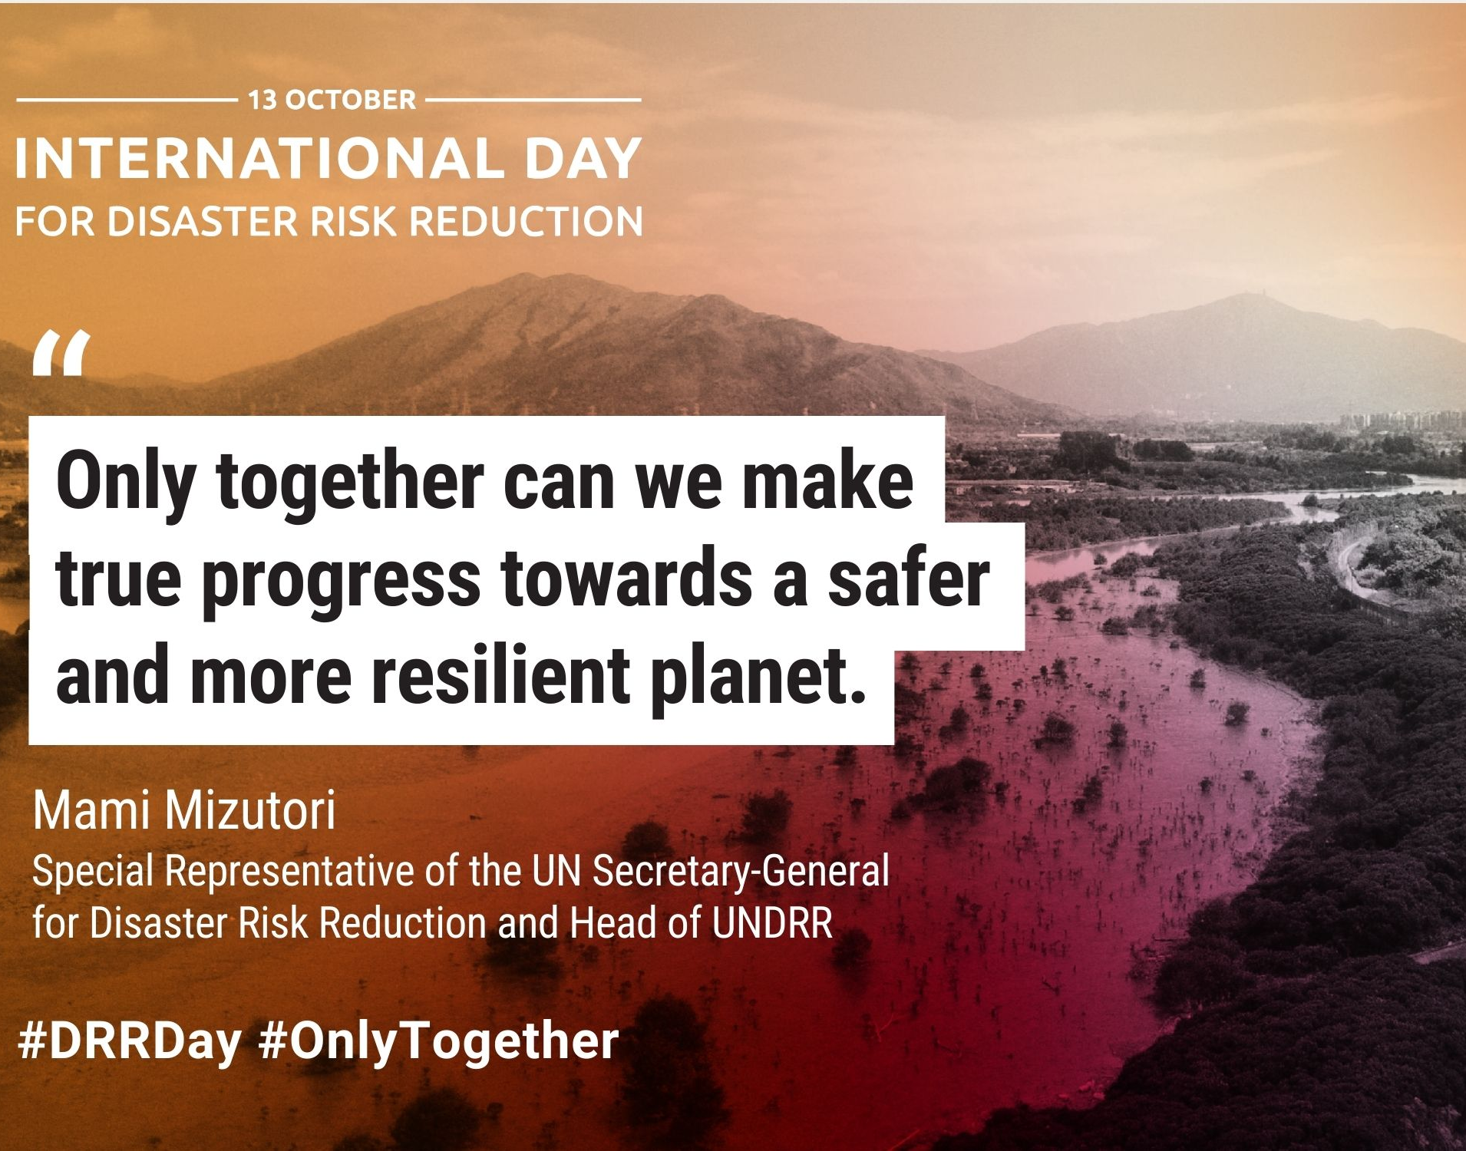
UNDRR & ROK > Multilateral Climate Action for People & Planet
International cooperation to developing countries for national Sendai Framework implementation
More international, regional and bilateral programmes are needed for DRR-related capacity development in developing countries
UNDRR ONEA & GETI established to promote disaster resilient societies and develop a cadre of professionals in DRR and climate change adaptation
Supports Korea’s “commitment to international cooperation to share experience and technologies with the international community to reduce disaster risk for humanity”
Notes:
So how does UNDRR support the Republic of Korea in advancing multilateral climate action for people and planet?
The Sendai Framework has 7 global targets: Target F calls to substantially enhance international cooperation to developing countries through adequate and sustainable support to complement national actions
Every October 13th, we celebrate the International Day for Disaster Risk Reduction – and this year we focus on Target F for international cooperation
One key IDDRR message is that more international, regional and bilateral programmes are needed for DRR-related capacity development in developing countries, which links to …
how UNDRR is supported by the Republic of Korea in advancing multilateral climate action for people and planet
The UNDRR Office in Incheon was established in 2010 with support of the Ministry of Interior and Safety and Incheon Metropolitan City to promote disaster resilient societies and develop a new cadre of professionals in the areas of disaster risk reduction and climate change adaptation
This support for international cooperation demonstrates Korea's commitment to international cooperation to share experience and technologies with the international community to reduce disaster risk for humanity (source: https://www.mois.go.kr/eng/sub/a03/internationalCooperation/screen.do)

Slide 13
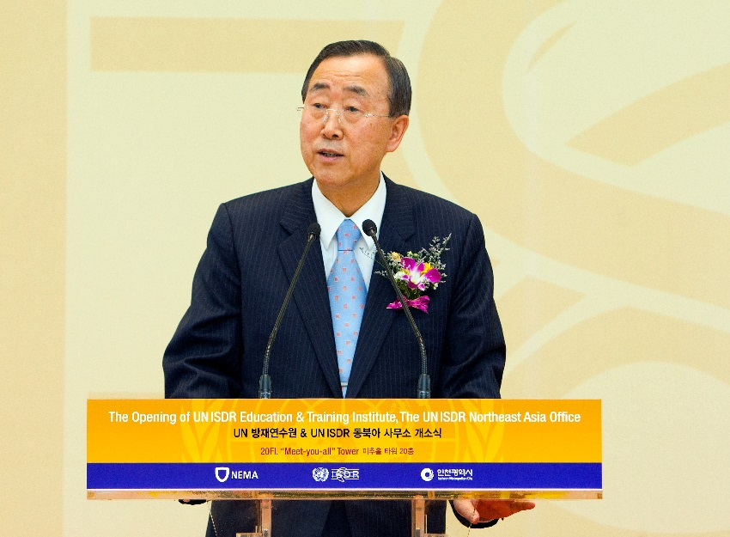
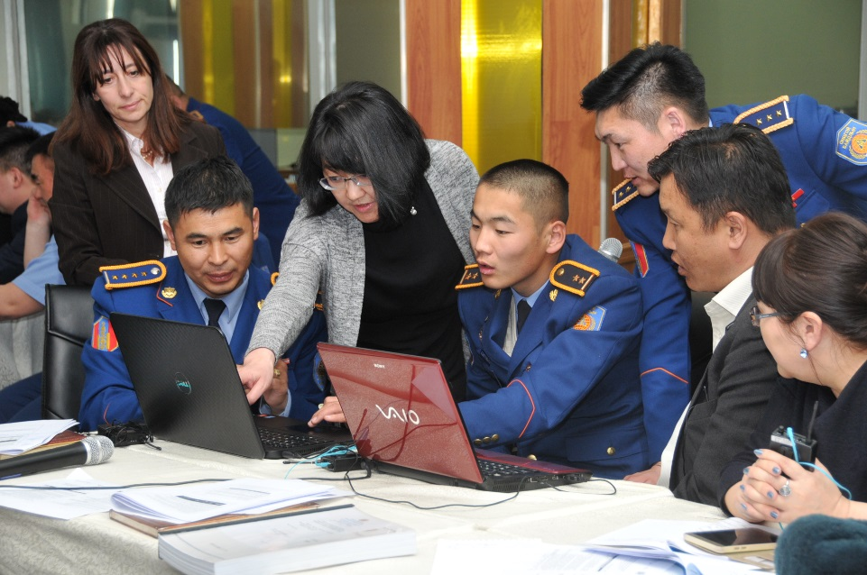
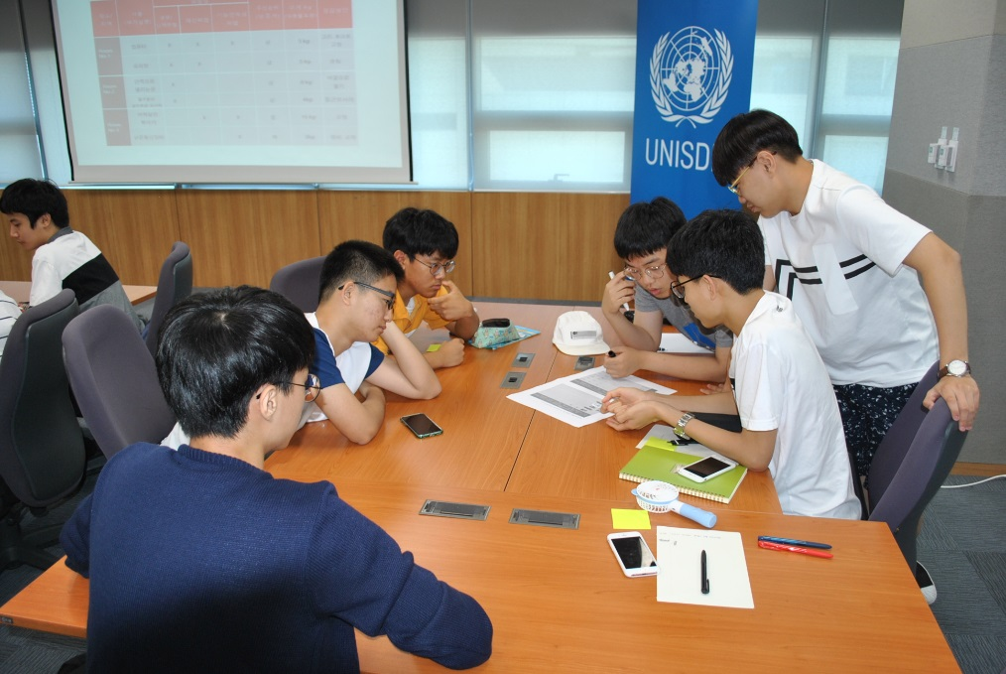
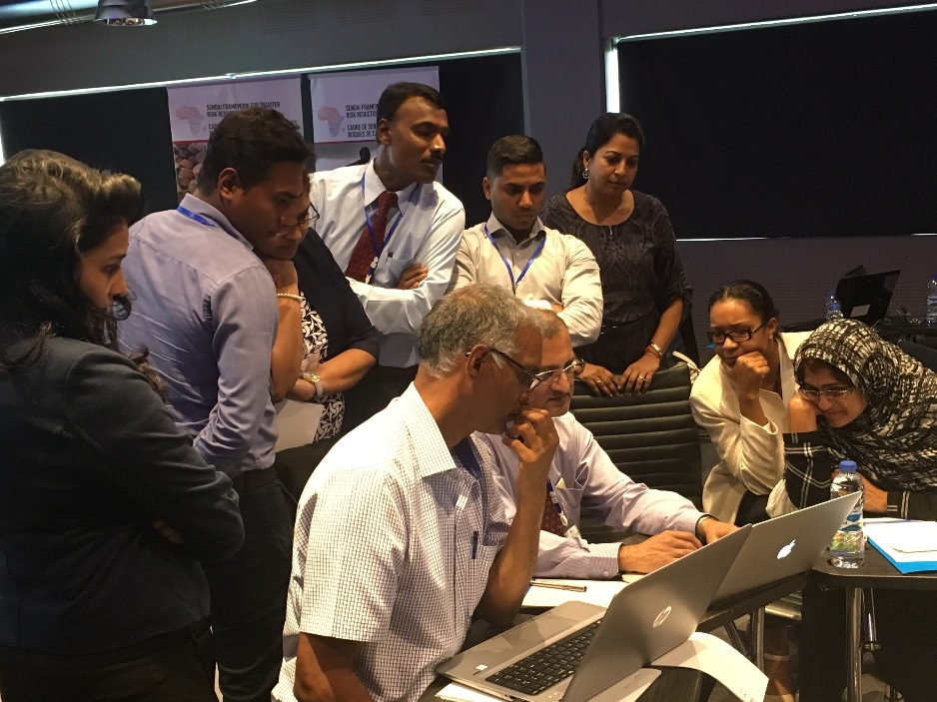

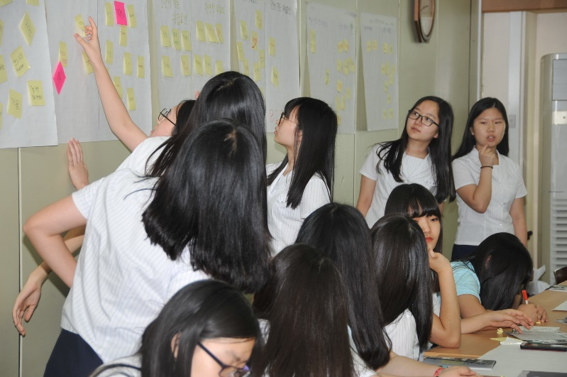
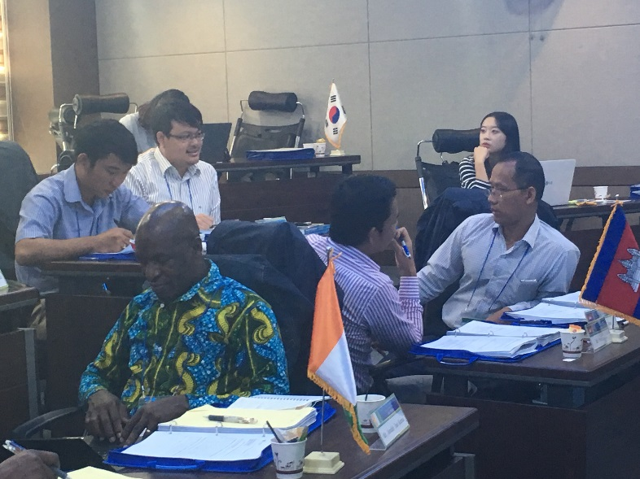
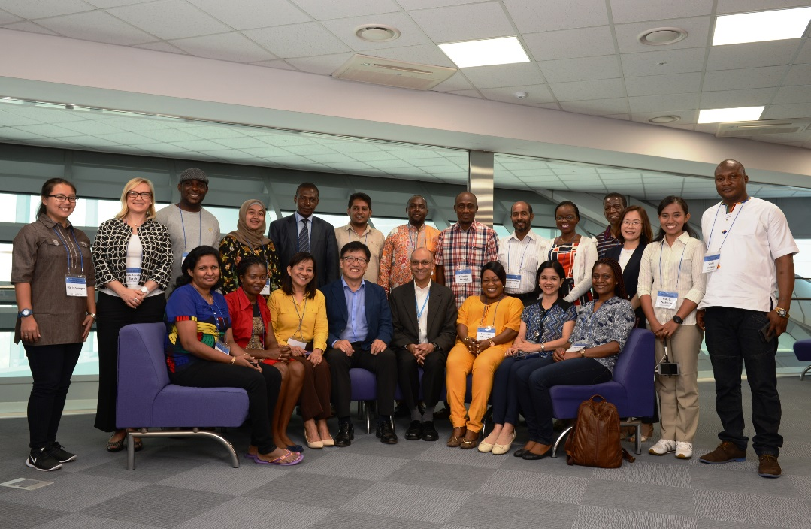
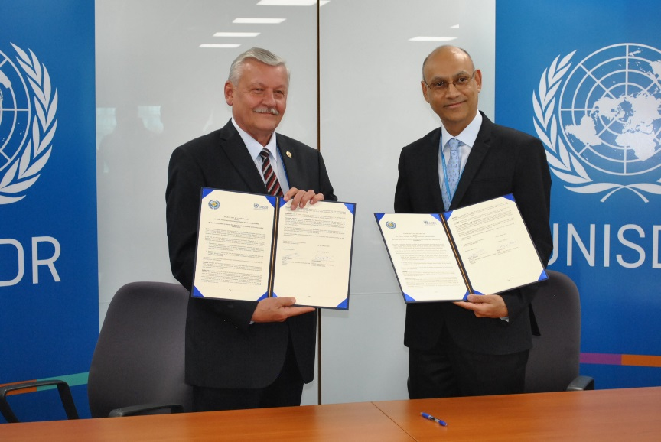
UNDRR & ROK > Multilateral Climate Action for People & Planet
UNDRR Office in Incheon for Northeast Asia & Global Education and Training Institute Result Highlights
Over 15,000 trained and 40,000 reached in events (2011- 2021) from 186 countries
Enhanced online outreach and training since COVID-19 - including early lessons from China and ROK shared globally
Coordinated the Making Cities Resilient (MCR) campaign of 4,000+ cities (until 2020) - including 175 Korean cities
Launched MCR2030 Initiative with global partners to ‘make DRR local’
Led UN Mission to DPR Korea to support the UN Country Team integrate DRR and climate change adaptation
Shared best DRR tech practice of China, Japan & Korea globally together with TCS
Korean School Safety Programme: Towards a culture of prevention: 4,415 students & 2,686 educators since 2011
Notes:
[Quickly touch on]
With this support and together with our partners :
GETI has trained over 15,000 professionals and reached over 40,000 participant in events from 186 countries who have integrated DRR and CC into policies, strategies and plans.
During the unprecedented challenges of 2020, brought by the arrival of the COVID-19 pandemic, UNDRR ONEA & GETI extended its role as a trainer online sharing early responses to COVID-19 from China and Korea.
As the global hub for the Making Cities Resilient campaign until 2020, UNDRR successfully launched the MCR2030 initiative and to enhance cities ability to know, plan and implement better linking them with a grand partnership for support.
UNDRR led UN Inter-Agency Mission to DPR Korea and will continue supporting risk informed development
Shared best tech for DRR practices
And here Korea, the Korean School Safety Programme: Towards a culture of prevention has reached 4,415 students & 2,686 educators since 2011 and been embedded in the national Disaster Safety programme while lessons have importantly been shared globally.
Later, we will hear from one Incheon High School student who participated in the programme and shared her knowledge at the Internatioal Tsunami Awareness Day in Japan.
All of this promotes multilateral climate and disaster risk reduction action.
Thank you.

Slide 14


Northwest Pacific Action Plan (NOWPAP)
LIU Ning, Programme Officer
Regional Coordinating Unit, NOWPAP
United Nations Environment Programme
Busan, Republic of Korea
Ning.liu@un.org

Slide 15


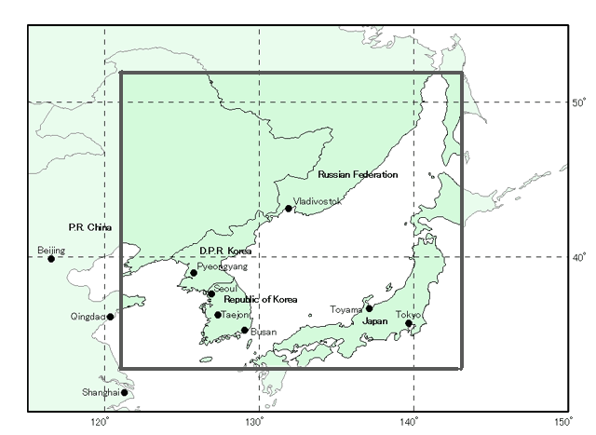
UNEP Northwest Pacific Action Plan
Established in 1994
Part of UN Environment Programme(UNEP)’s Regional Seas Programme
Member states: China, Japan, Korea, Russia
Overall goal: Protection of the marine and coastal environment in the region
www.unep.org/nowpap
Notes:
The control, halting and prevention of any further degradation and deterioration of the coastal and marine environment and its resources;
The recovery and rehabilitation of coastal and marine environments that have been degraded and which still have the potential for such a recovery;
The long-term sustainability of coastal and marine environmental quality and resources as assets for the present and future human populations of the region.

Slide 16

NOWPAP Mechanism
National Focal Points
Research Institutes/ NGOs
Regional Activity Center
CEARAC
DINRAC
MERRAC
POMRAC
Special Monitoring and
Coastal Assessment (Toyama)
Intergovernmental Meeting (IGM)
Regional Coordinating Unit (RCU)
Regional Activity center (RACs)
- Data and Information (Beijing)
- Marine Environment Emergency
Preparedness and Response (Daejeong)
- Pollution Monitoring (Vladivostok)
Notes:
.

Slide 17
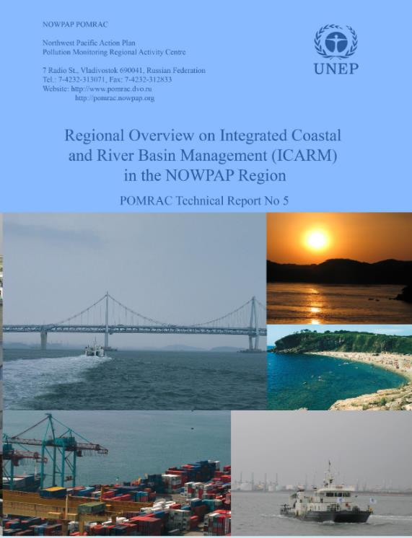
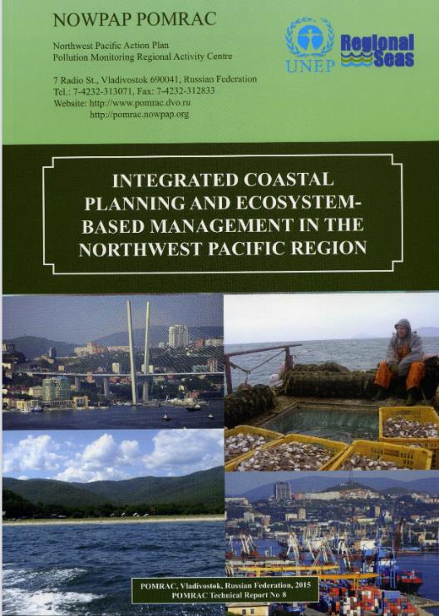
Integrated coastal and river basin management
2010
2013

Slide 18
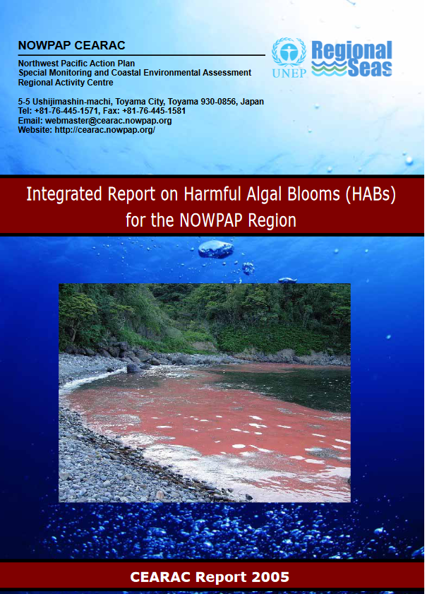
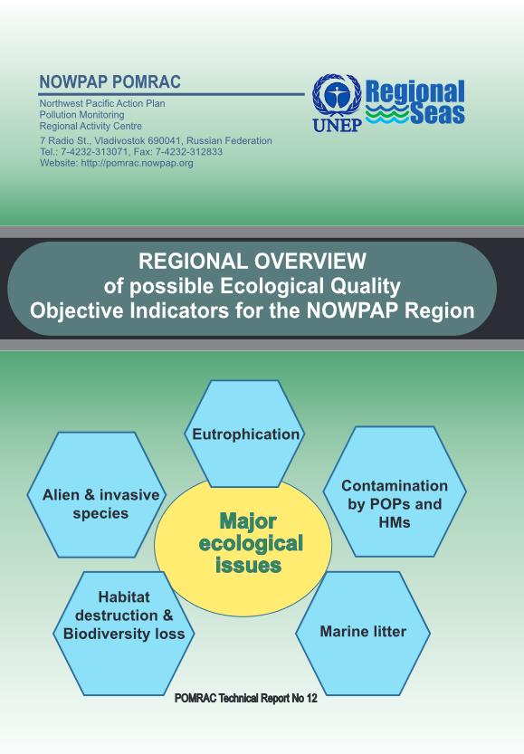
Assess Status of Marine Environment

Slide 19
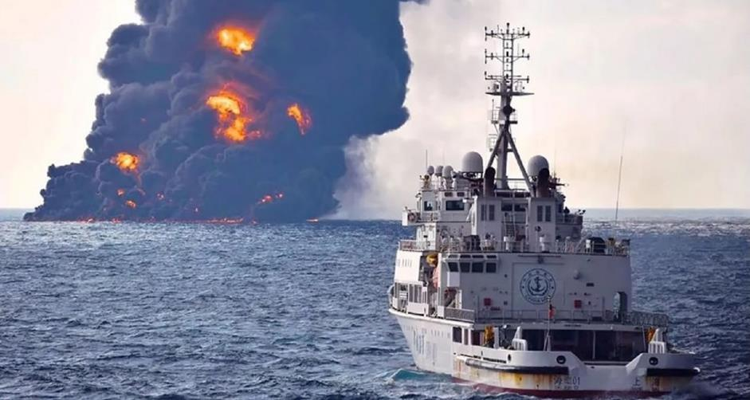
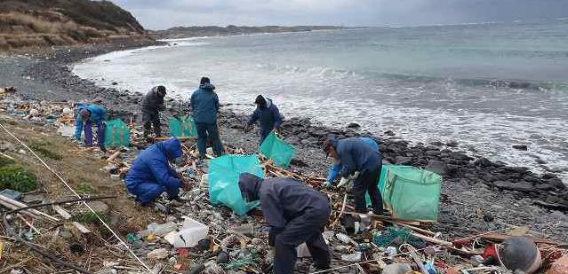
Prevent and Reduce Pollution
Regional Oil and NHS (Hazardous and Noxious Substances) Spill Contingency Plan adopted in 2008
Oil Spill accident (Sanchi, Jan 2018)
Regional Action Plan on Marine Litter agreed by member states in 2008

Slide 20
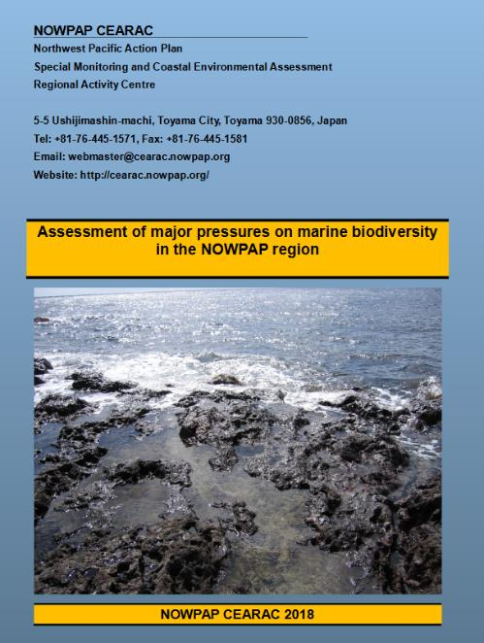
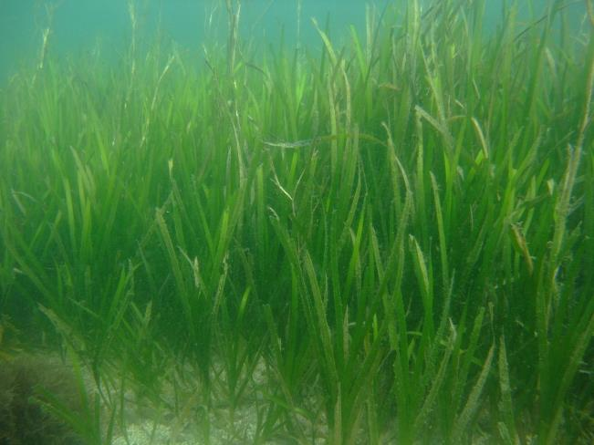
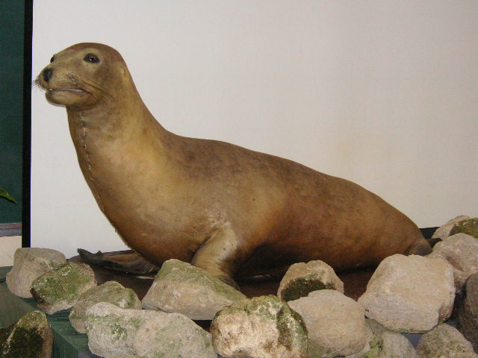
Conserve Biodiversity
Regional Action Plan on Marine and Coastal Biodiversity Conservation
IUCN red list species in the region
Assess seagrass blue carbon
Notes:
Our empirical relationships predicted that the ranges of five of the fish species examined will shift
poleward by 19–71 km from the 2000s to the 2030s. The strongest relationships between mean
latitude and sea surface water temperatures were observed for the large pelagic species, Spanish
mackerel and yellowtail. We conclude that large pelagic species will respond most sensitively to
warming oceans in their distribution range. Despite their greater decadal variability in recruitment,
small pelagic species seem to be more resilient than large pelagic species to climate change in their
distribution range. Long-term plans need to be made, especially in regard to large pelagic species, to
adapt fisheries to climate change and global warming (e.g., vessels equipped with freezers for
preserving tuna for more profitable marketing).

Slide 21

Food and Agriculture Organization of United Nations (FAO)
Partnership and Liaison Office in the Republic of Korea
Ms. Nara Lee, Assistant Representative
Notes:
Fao full name . Fao logo,

Slide 22
FAO’s mandate
Raise levels of nutrition, improve agricultural productivity, better the lives of rural populations and contribute to the economic growth of the world By achieving food security for all is at the heart of FAO's efforts – to make sure people have regular access to enough high-quality food to lead active, healthy lives.
FAO & Republic of Korea
Republic of Korea joined FAO in November 1949 72 years of membership, partnership and cooperation
Notes:
Our mandate is to improve nutrition, increase agricultural productivity, raise the standard of living in rural populations and contribute to global economic growth.
Many national efforts were made :
policy formation, capacity building, strong leadership, ​Saemaul movement

Slide 23

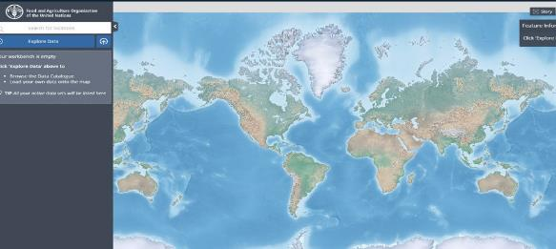
1. How your mandate contributes to ROK’s multilateral efforts on protecting people?
Contributing to achieving 2030 SDGs, SDGs 1, 2 and 10 in particular
FAO as custodians of 62 out of 232 SDG indicators
FAO’s Strategic Framework 2022-2031
4 Betters (4Bs): better production, better nutrition, a better environment, and a better life, leaving no one behind
FAO’s Main Initiatives and Programmes
Hand-in-Hand Initiative (HIHI) COVID-19 Response and Recovery Programme Digital Village Initiative (DVI) 20 PPAs
FAO’s collaborations with ROK 7th voluntary contributor (28 funded projects)
XV World Forestry Congress, Seoul, Republic of Korea, May 2021 Smart Farming for the Future Generation The Forest and Landscape Restoration Mechanism Implementation of Codex standards to support containment and reduction of foodborne AMR
Notes:
Hand-in-Hand geospatial platform​
[Hand-in-Hand] boasts over one million geospatial layers and thousands of statistics series with over 4 000 metadata records, bringing together geographic information and statistical data on over ten domains linked to food and agriculture ‒ from food security, crops, soil, land, water, climate, fisheries, livestock to forestry. It also includes information on COVID-19’s impact on food and agriculture. ​
https://data.apps.fao.org/ ​
How many targets and indicators does SDG have?
The 17 Sustainable Development Goals are defined in a list of 169 SDG Targets. Progress towards these Targets is agreed to be tracked by 232 unique Indicators. Here is the full list of definitions.
https://sdg-tracker.org/

Slide 24
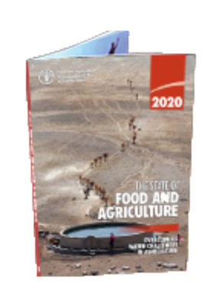
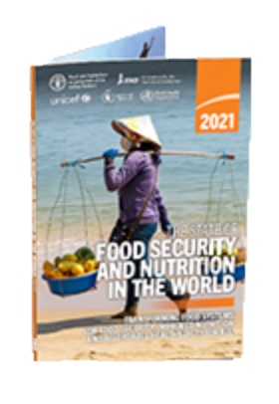
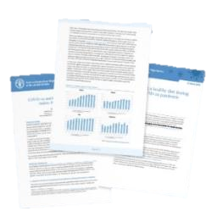
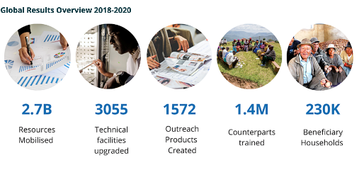

2. How your mandate contributes to ROK’s multilateral efforts on protecting planet?
1. Putting information within reach
Flagship publications and statistics for better decision making
2. Providing policy support
Food Security and Food Safety, Sustainable Agriculture and Rural Development (SARD), Smart Agriculture, Climate Change Response, One Health (TAD, FAW and AMR), Sustainable Food Systems
3. Developing capacity building
Technical Cooperation Programme (TCP), technical and technology transfer, CB
4. Sharing know-how, skills and expertise
ASEAN+3, South-South and Triangular Cooperation (SSTC)
5. Support and provide meeting place for nations
WFS 1996, WFS 5 years later 2001, UN Food Systems Summit 2021
Notes:
4. Bilateral and multilateral programme/projects
To address global concerns such as FS and food safety, SARD, climate mitigation and adaptation, sustainable food systems, etc

Slide 25
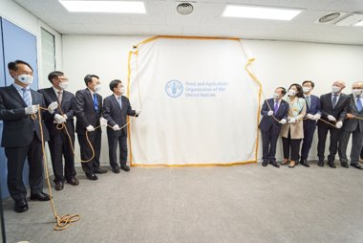
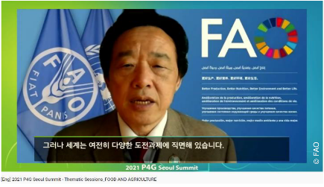
3. How our offices support and/or are supported by ROK in advancing multilateral climate for people and planet?
Role of FAO Partnership and Liaison Office in the Republic of Korea
Promoting visibility and outreach of FAO and ROK Building and strengthening partnership between FAO and ROK Aligning priorities of ROK with FAO programmes and priorities for resource mobilization
Work of FAO Partnership and Liaison Office in the Republic of Korea
Supporting ROK's national priorities such as P4G (Partnering for Green Growth and the Global Goals 2030) Seoul Summit, National Dialogues, first International Forum on Eco-Farming (IFEF) Partner with other UN agencies for global and regional solutions
Launching ceremony of operational PLO​
(8 April 2021) ​
DG giving keynote speech at P4G Seoul Summit
(31 May 2021) ​

Slide 26
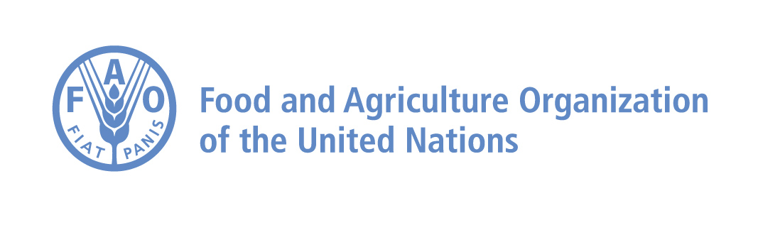


Thank you!
감사합니다!
World Health Organization
Asia-Pacific Centre for Environment and Health
in the Western Pacific Region
(WHO ACE)
22nd October
Ms Jinwon Yi
National Professional Officer
Contact: fao-kr@fao.org

Slide 27
Protecting people: The WHO-ACE Goals
ACE is a Knowledge Hub for WHO secretariat to support Member States in articulating policy options in areas relating to climate change, environmental degradation and health such as
  Air quality and health; Climate change and health; Water and Living Environment
ACE is to perform its functions to collect, synthesize and analyze evidence and shape it for use by Member States
ACE is an integral part of WHO Western Pacific Regional Office, in which several teams works collaboratively on environmental health, including
  WHO Asia-Pacific Centre for Environment and Health in the Western Pacific Region (ACE)
  Division of Healthy Environments and Populations
  Division of Pacific Technical Support
  Division of Health Security and Emergencies

Slide 28
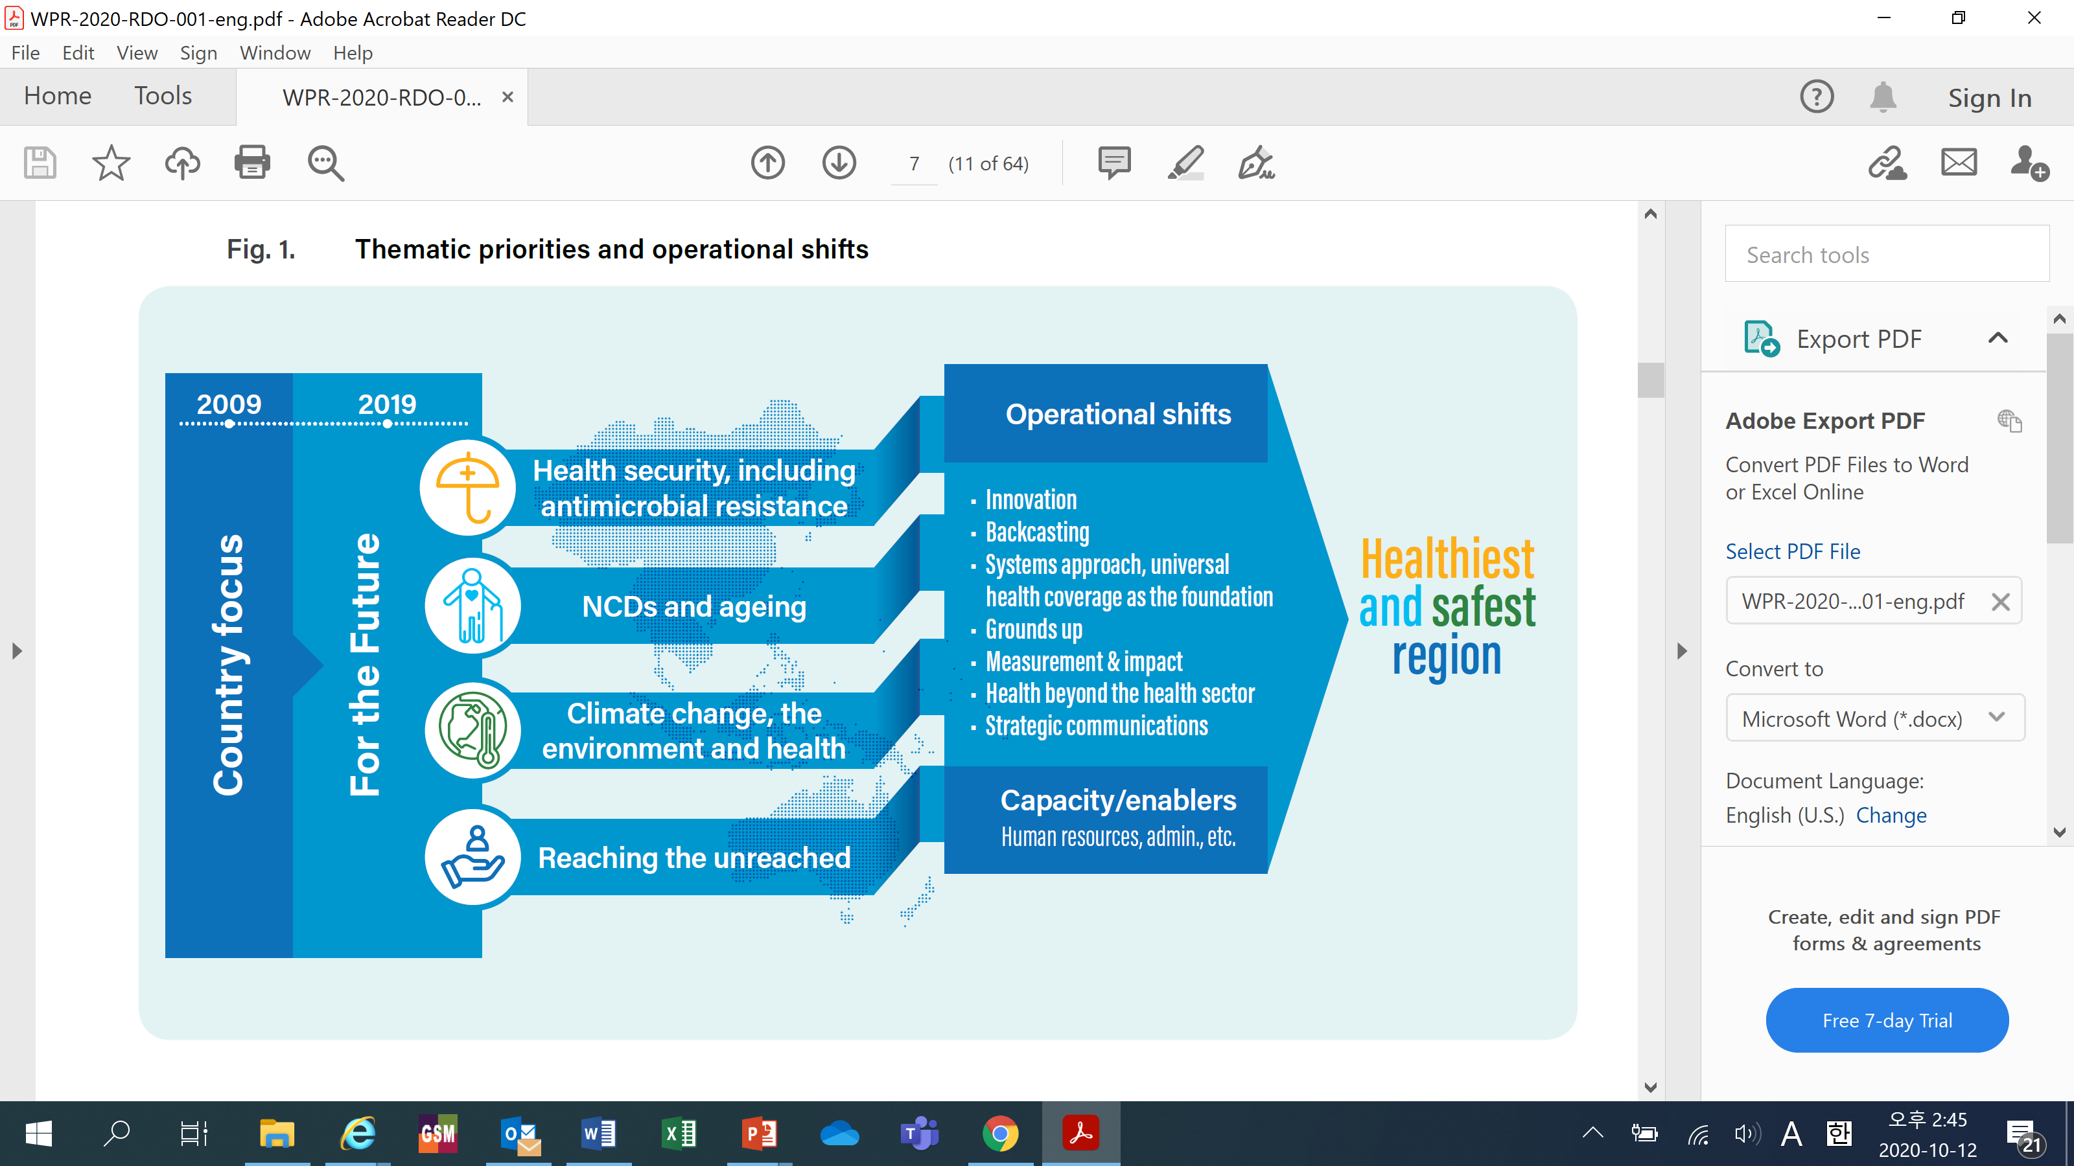
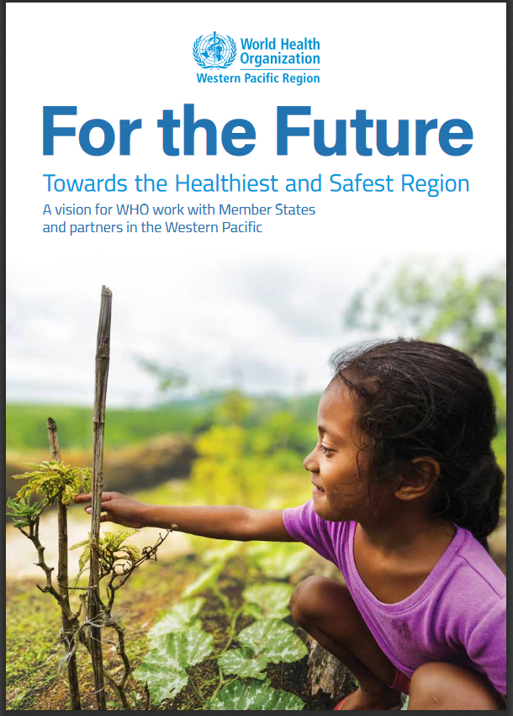
Protecting people: “For the Future”
“For the Future” is a shared vision by WHO and Member States, endorsed in 2019 at Regional Committee Meeting, the regional governing body
“For the Future” identifies climate change and the environment (CCE) as one of four thematic priorities for the region going forward
Notes:
WHO’s efforts on protecting people is shown at the white paper named “For the future”
For the Future articulates a shared vision for WHO’s work with Member States and partners in the coming years.
This is strategic vision paper for 2020-2024.

Slide 29
Protecting Planet: Climate change, the Environment and Health (2020-2024)
Notes:
The ROK's multilateral efforts on protecting planet would be linked to the efforts on climate change mitigation and adaptation.
In August 2019, at the 13th Pacific Health Ministers Meeting, the Regional Director announced the establishment of a WHO regional platform on climate change, environment and health (CCE Platform) as a way of facilitating the implementation of the CCE Thematic Priority.
To support the implementation of the thematic priority and to act as the engine of the CCE Platform, the technical advisory group on climate change, environment and health (CCE TAG) was established in April 2020.

Slide 30
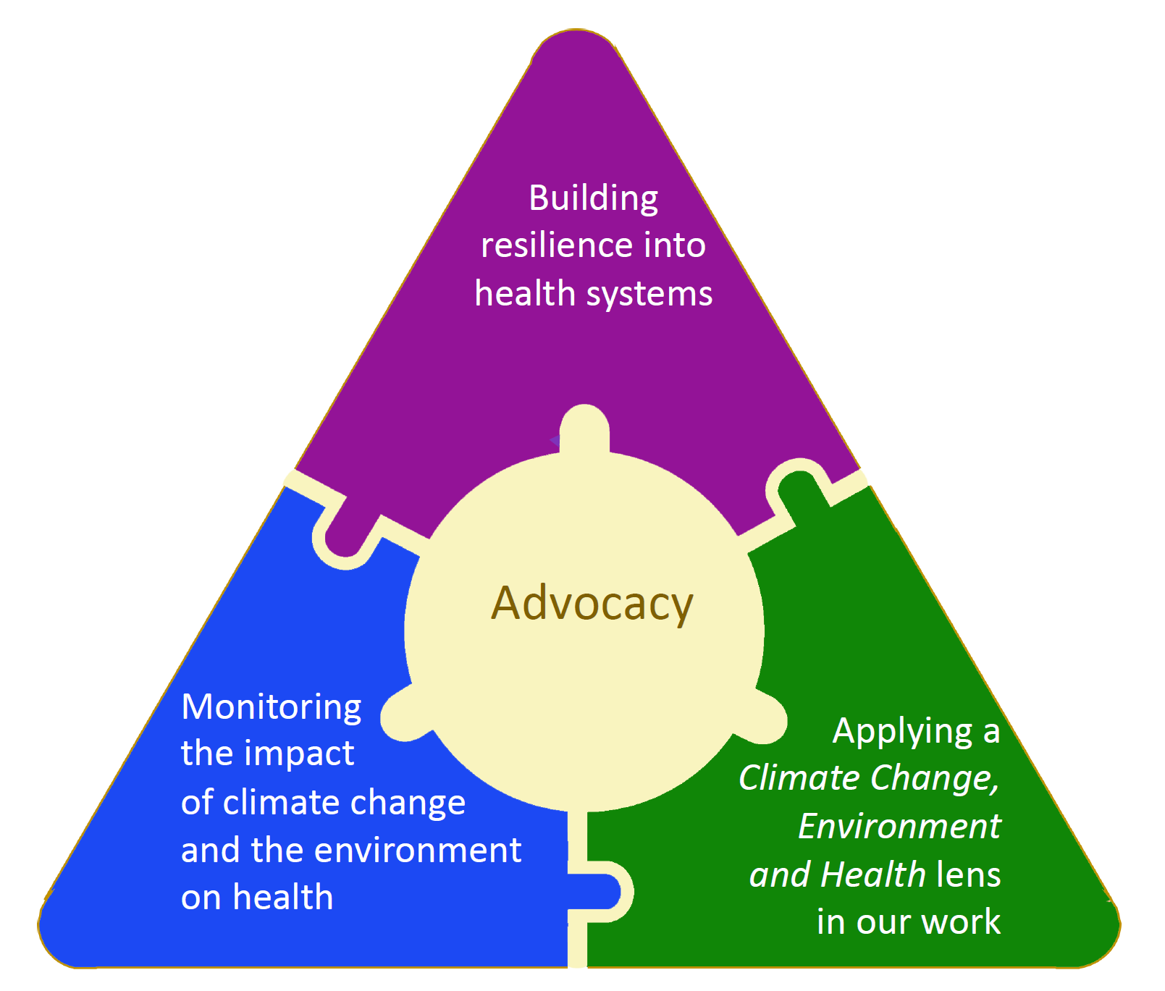
Climate Action:
Technical Advisory Group on CCE
Notes:
ACE could support and be supported by ROK in advancing multilateral climate action for people and planet by actions and activities from Technical advisory group on Climate Change, the Environment and health.
We will try to implement the priorities of four pillars of the CCE thematic priority:
Pillar 1 - providing advocacy (raising the profile of the CCE agenda by building new narratives and articulating health co-benefits of actions and policies from non-health sectors);
Pillar 2 - building resilience into health systems (to withstand the impacts of climate change and environmental threats including strengthening capacity to respond to emerging infectious diseases due to climate change);
Pillar 3 - monitoring the impact of climate change and the environment on health (to provide timely, accurate and strategic information to inform decision-making, guide advocacy, drive action, and track impacts and success of interventions); and
Pillar 4 - applying a climate change and environment lens to our work (where all WHO staff in the Region understand the health impacts and act as agents of change, making their contribution towards achieving the healthiest and safest region).

